Slide 1





Language-Agnostic Detection of
Bugs in ZKP Programs
Arman Kolozyan, Bram Vandenbogaerde, Janwillem Swalens,
Lode Hoste, Stefanos Chaliasos, Coen De Roover
Notes:
So thank you once again for giving me the opportunity to present this work. My name is Arman, I am currently interning/doing a predoc at MPI-SP working with Carmela. But today I will present the research I did as part of my Master's thesis, which was a joint work with my supervisors at Nokia Bell Labs, UCL, and zkSecurity, which is an auditing company for zero-knowledge proof programs. Because indeed
In this talk, I will first explain
What ZKPs are
What their programming model is
Why there is a need for a bug detector
Before getting into the contributions

Slide 2




Zero-Knowledge Proofs
IClaim: I know p and q so that N = pq
N =
pq
p, q
pq
N ≠
1
Notes:
so suppose that there is a large value N, and I make a claim that I know 2 primes ...
From mathemtics we know that this isn’t a trivial task
But what if I don’t want to reveal those primes
Or I want you to verify my proof directly, without even doing the multiplication.
So these are the two main properties of ZKPs

Slide 3
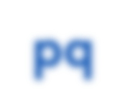
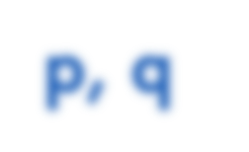
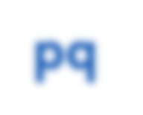
Zero-Knowledge Proofs
IClaim: I know p and q so that N = pq
secret?
N =
N ≠
2
Notes:
so suppose that you send to me a large value N, and I make a claim that I know 2 primes ...
But what if I don’t want to reveal those primes
Or I want you to verify my proof directly, without even doing the multiplication.
So these are the two main properties of ZKPs

Slide 4
Zero-Knowledge Proofs
IZero-Knowledge Proof (ZKP)
I keep some
data secret
I verify your proof quickly
proof
PROVER
VERIFIER
3
Notes:
So what ZKPs allow us to do, is create a proof that a certain statement is true, I can send that proof over to you, and you can verify it without seeing all the secret data. So in this proof, I can choose to keep some data hidden from this verifier, for example the p and q
Another nice property of ZKPs is that this verification can happen very quickly, often in constant time, no matter how complex the statement is that you want to prove.

Slide 5

Applications: Privacy
4
Notes:
The applications of zero-knowledge proofs follow directly from these two properties.

Slide 6
Applications: Privacy
5

Slide 7
Applications: Privacy
5

Slide 8


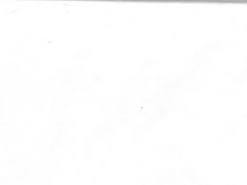
Applications: Succinctness
6
Notes:
As we know, blockchains are inherently slow, whick makes scalability a challenge. ZKPs, the succinctness aspect of it, help overcome this by allowing complex computations to be performed off-chain, so out of the blockchain.
compared to the blockchain: supercomputer

Slide 9
Applications: Succinctness
7

Slide 10


Applications: Succinctness
work
output, proof
Programmable!
8
Notes:
There is a lot of mathematics and cryptography magic that makes it possible to hide the data while still proving the statement, and making verification quickly, but ON OUR LEVEL OF ABSTRACTION WE JUST ASSUME THE MAGIC IS THERE.
And these are two concrete ZKP use cases that make use of that magic, but they are both just things you want to prove (…). And since these things can be expressed as programs, we can write them in dedicated ZKP programming languages, which is where development comes in.
So let’s say that I want to build such an application, how do I go on about that?

Slide 11


ZKP Pipeline
PROVER
template Name() {
signal private input a;
signal input b;
signal output out;
...
}
PROOF
IDEA
ZKP PROGRAM
VERIFIER
privacy
succinctness
9
Notes:
So you have a certain idea, for example a program to verify the nationality of someone. Then what you have to is write z ZKP program. This is not a regular program because you have to write it in a ZKP-specific programming language, and that comes with its own syntax for example …
From this program,
Verifier will check whether this proof is valid, or in other words whether it was generated from this program, without seeing the private inputs.
Example: the prover will get the date of brith from the passport, calculate the age, ..
The verifier will check whether you correctly took the date of brith from the passport, correctly calculated the age, ...

Slide 12


ZKP Pipeline
PROVER
template Name() {
signal private input a;
signal input b;
signal output out;
...
}
PROOF
IDEA
ZKP PROGRAM
VERIFIER
privacy
succinctness
10

Slide 13
ZKP Pipeline
PROVER
template Name() {
signal private input a;
signal input b;
signal output out;
...
}
PROOF
IDEA
ZKP PROGRAM
VERIFIER
privacy
succinctness
11
Notes:
It then gives the necessary stuff for the prover to generate a proof, and for the verifier to check the proof.

Slide 14
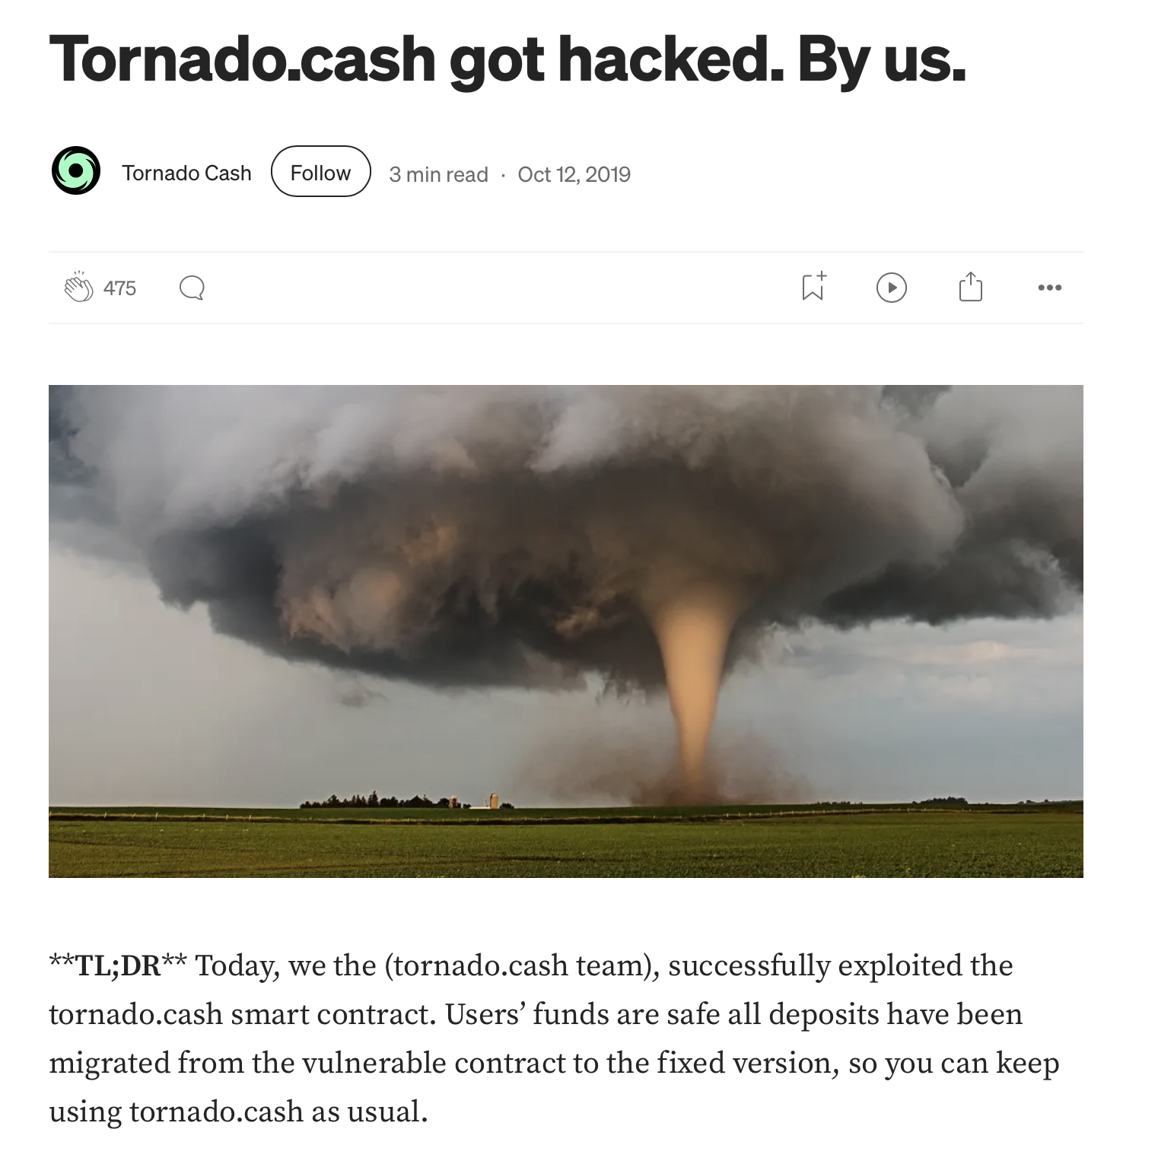
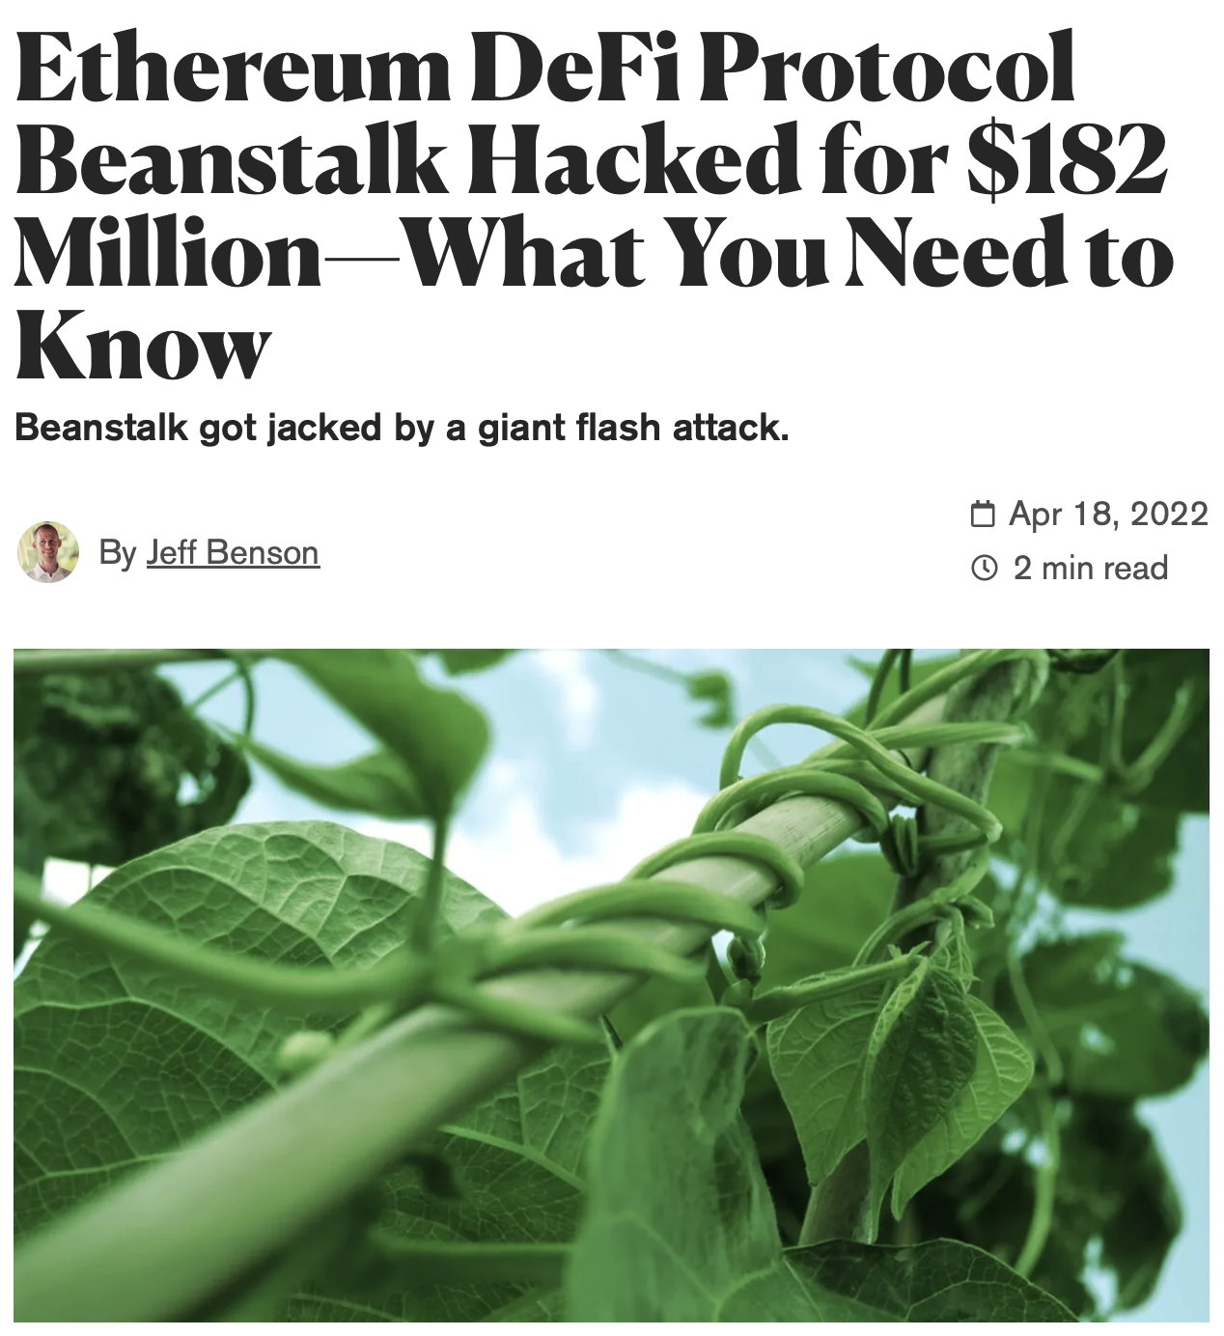
Bugs in ZKPs
Bugs in blockchain software are extremely costly
12
Notes:
ZKPs are used in blockchain context
“small” bugs can then have very severe consequences
attackers could create fake coins and it could lead to the loss of millions of dollars

Slide 15
Contributions
Formalization: Domain Consistency Model (DCM)
Algorithm: Value Inference Engine
Implementation: Multi-Language Support
Evaluation: Discovery of Real-World Vulnerabilities
Notes:
Which we call ... In which we formalized
What is a ZKP program? When is such a program correct, and more importantly when is it not correct? What are the then types of vulnerabilities in this context?
Then we turned that formalization into an algorithm for efficiently detecting vulnerabilities?
Then when the time came to implement this algorithm, we investigated whether there is a need to support multiple ZKP languages, and if so, how we could achieve multi-language support.
And finally, as part of the evaluation, we discovered several real-world vulnerabilities that can only be captured by our formal model, that I would like to briefly discuss
But to understand these first contributions, we need some background

Slide 16
Background

Slide 17
ZKP Pipeline
template Name() {
signal private input a;
signal input b;
signal output out;
...
}
IDEA
ZKP PROGRAM
15
Notes:
BECAUSE IF WE GO BACK TO WHERE WE LEFT OFF, I MENTIONED

Slide 18
ZKP Pipeline
out <-- a * b
template Name() {
signal private input a;
signal input b;
signal output out;
out <-- a * b;
out === a * b;
}
IDEA
ZKP PROGRAM
out === a * b
16
Notes:
It is important that they match, in the sense that the verifier needs to check exactly the things an honest prover is expected to do. So that if we have a cheater who creates fakes proofs, we can detect.

Slide 19
ZKP Pipeline
out <-- a * b
template Name() {
signal private input a;
signal input b;
signal output out;
out <-- a * b;
out === a * b;
}
a: 4
b: 2
out: 8
IDEA
8 === 4 * 2?
ZKP PROGRAM
out === a * b
17

Slide 20
ZKP Pipeline
out <-- a * b
template Name() {
signal private input a;
signal input b;
signal output out;
out <-- a * b;
out === a * b;
}
IDEA
+, *, ===
ZKP PROGRAM
out === a * b
18
Notes:
which causes complexities, because ...

Slide 21
Prover-Verifier Mismatches
out <-- a / b
template Name() {
signal private input a;
signal input b;
signal output out;
out <-- a / b;
}
a: 4
b: 2
out: 2
IDEA
ZKP PROGRAM
?????????????
19

Slide 22
Prover-Verifier Mismatches
out <-- a / b
template Name() {
signal private input a;
signal input b;
signal output out;
out <-- a / b;
out * b === a;
}
a: 4
b: 2
out: 2
IDEA
2 * 2 === 4?
ZKP PROGRAM
out * b === a
20

Slide 23

Prover-Verifier Mismatches
out <-- a / b
template Name() {
signal private input a;
signal input b;
signal output out;
out <-- a / b;
out * b === a;
}
a: 4
b: 0
out: 2
Division by Zero!
IDEA
ZKP PROGRAM
out * b === a
21
Notes:
If we look back to why this happened (more expressiveness)
What the developer forgot to do

Slide 24

Prover-Verifier Mismatches
out <-- a / b
template Name() {
signal private input a;
signal input b;
signal output out;
out <-- a / b;
out * b === a;
}
a: 4
b: 0
out: 2
a: 0
b: 0
out: 5
Division by Zero!
IDEA
5 * 0 === 0?
ZKP PROGRAM
out * b === a
22
Notes:
what we are missing here

Slide 25
Signal Tags
out <-- a / b
template Name() {
signal private input a;
signal input {nonZero} b;
signal output out;
out <-- a / b;
out * b === a;
}
a: 4
b: 0
out: 2
Reason: performance
Many such assumptions
appear in library templates
Compiler does not verify
a: 0
b: 0
out: 5
IDEA
5 * 0 === 0?
ZKP PROGRAM
out * b === a
23
Notes:
CALLER
minimize #constraints
if we would have

Slide 26
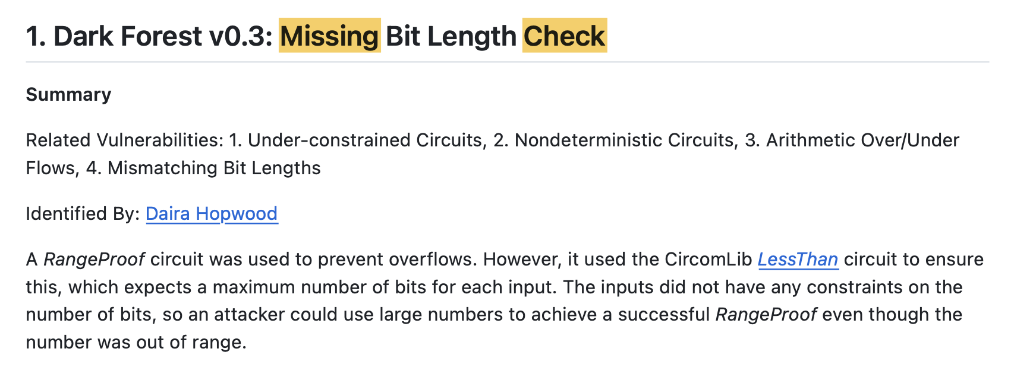
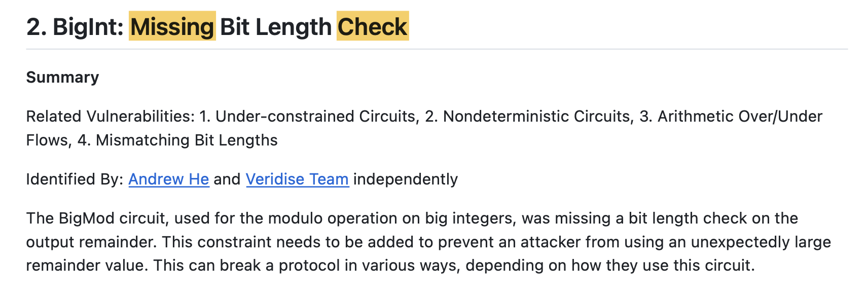
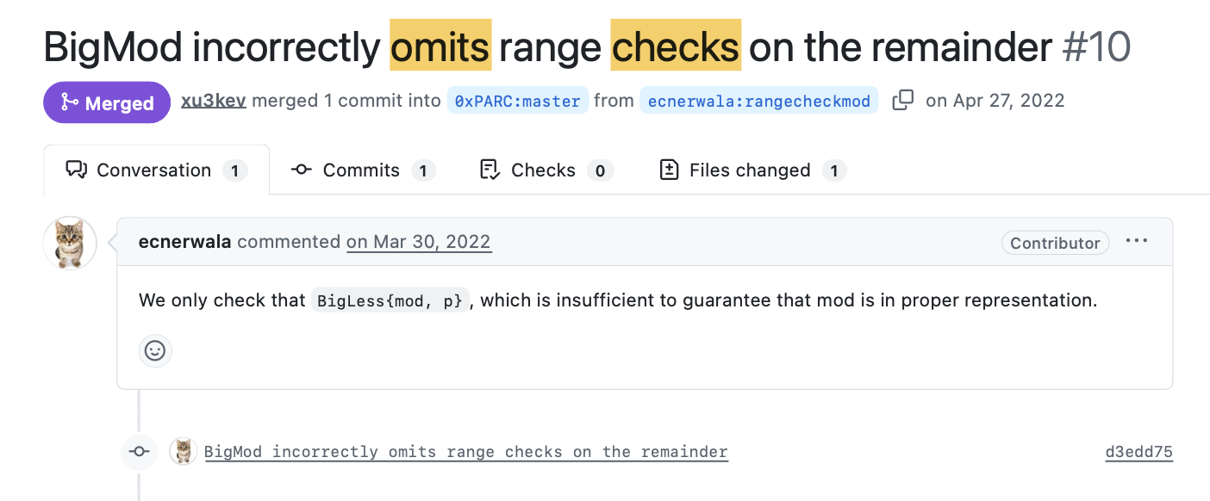
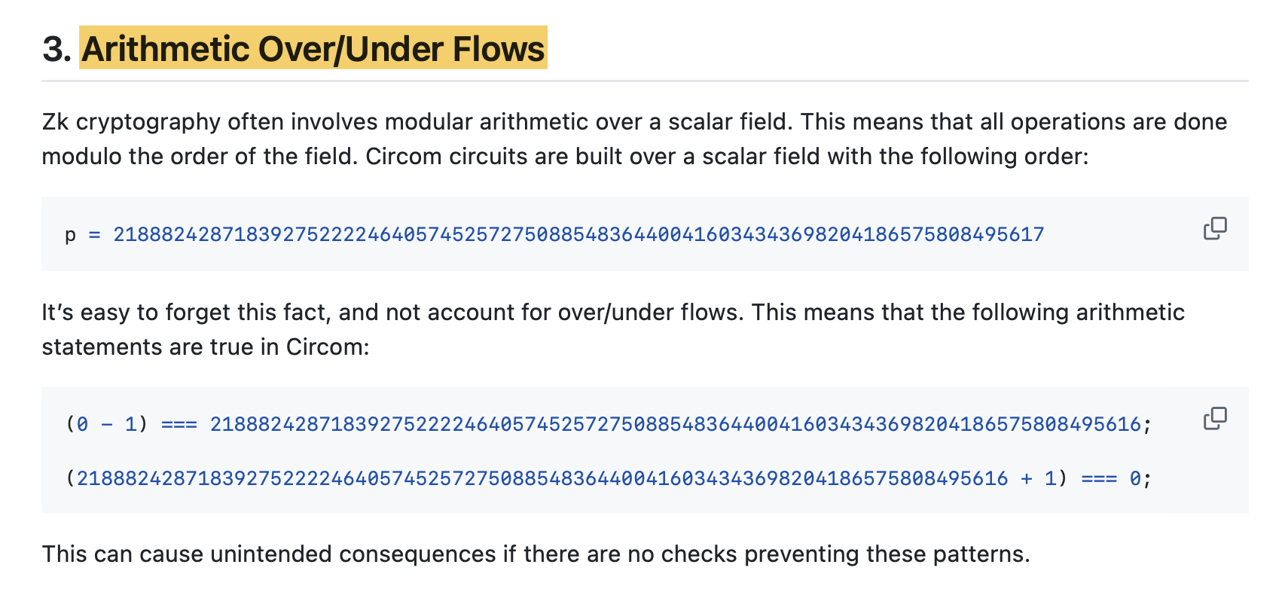
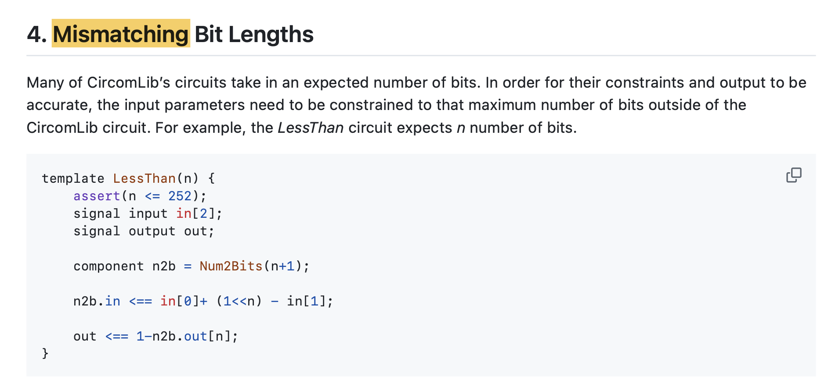
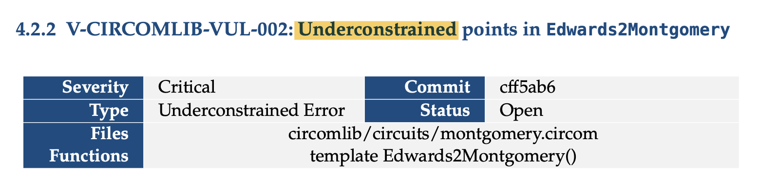
Bug Examples
[0xPARC/zk-bug-tracker, GitHub]
24
Notes:
AND SUCH BUGS HAVE BEEN IDENTIFIED IN THE WILD. HERE ARE EXAMPLES FROM BUG REPORTS and BUG TRACKERS DESCRIBING VULNERABILITIES IN THE CONTEXT OF ZKP LANGUAGES.

Slide 27
Related Work: Target & Scope
Need for Language-Agnostic techniques
Many detectors target a single DSL
Tool | Target
Circomspect | Circom
Picus | R1CS
ConsCS | Circom
CIVER | Circom
ZKAP | Circom
ZEQUAL | Circom
zkFuzz | Circom, Noir
27

Slide 28

Related Work: Target & Scope
Need for Language-Agnostic techniques
Many detectors target a single DSL
Tool | Target | Constraints
Circomspect | Circom
Picus | R1CS
ConsCS | Circom
CIVER | Circom
ZKAP | Circom
ZEQUAL | Circom
zkFuzz | Circom, Noir
28

Slide 29


Related Work: Target & Scope
Need for Language-Agnostic techniques
Many detectors target a single DSL
Tool | Target | Constraints | Mismatches
Circomspect | Circom
Picus | R1CS
ConsCS | Circom
CIVER | Circom
ZKAP | Circom
ZEQUAL | Circom
zkFuzz | Circom, Noir
Need for Semantic Mismatch Detection techniques
No general technique to detect semantic mismatches between computations and constraints
29
Notes:
If we for example wouldn't have analyzed the prover side, where the developer has very expressive operations it can use, we would never have known that we wanted to do division and hence check the nonzero-property.

Slide 30
Related Work: Technique
Many tools …
… only analyze the verifier
… have scalability issues
… target a single DSL
25
Notes:
AND SUCH BUGS HAVE BEEN IDENTIFIED IN THE WILD. HERE ARE EXAMPLES FROM BUG REPORTS and BUG TRACKERS DESCRIBING VULNERABILITIES IN THE CONTEXT OF ZKP LANGUAGES.

Slide 31
Related Work
Many tools …
… only analyze the verifier
… have scalability issues
… target a single DSL
26
Notes:
OUR WORK SITUATES IN THE STATIC ANALYSIS WORLD AND OUR EXACT CONTRIBUTIONS

Slide 32
Contributions
Formalization: Domain Consistency Model (DCM)
Algorithm: Value Inference Engine
Implementation: Multi-Language Support
Evaluation: Discovery of Real-World Vulnerabilities
Notes:
Formal definitions and proofs in the paper

Slide 33
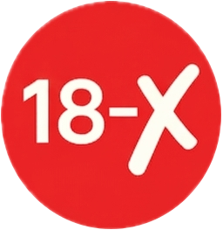
Underconstrained = Nondeterminism?
23
Notes:
BUT WHAT IF THE APPLICATION WAS PROGRAMMED IN A WAY THAT HAD A MISTAKE

Slide 34
Underconstrained = Nondeterminism?
To detect wrong deterministic programs, we also need access to the computations.
deterministic
nondeterministic
To detect nondeterminism, we only need access to the constraints:
same input => ++ accepted outputs?
23
Notes:
BUT WHAT IF THE APPLICATION WAS PROGRAMMED IN A WAY THAT HAD A MISTAKE

Slide 35
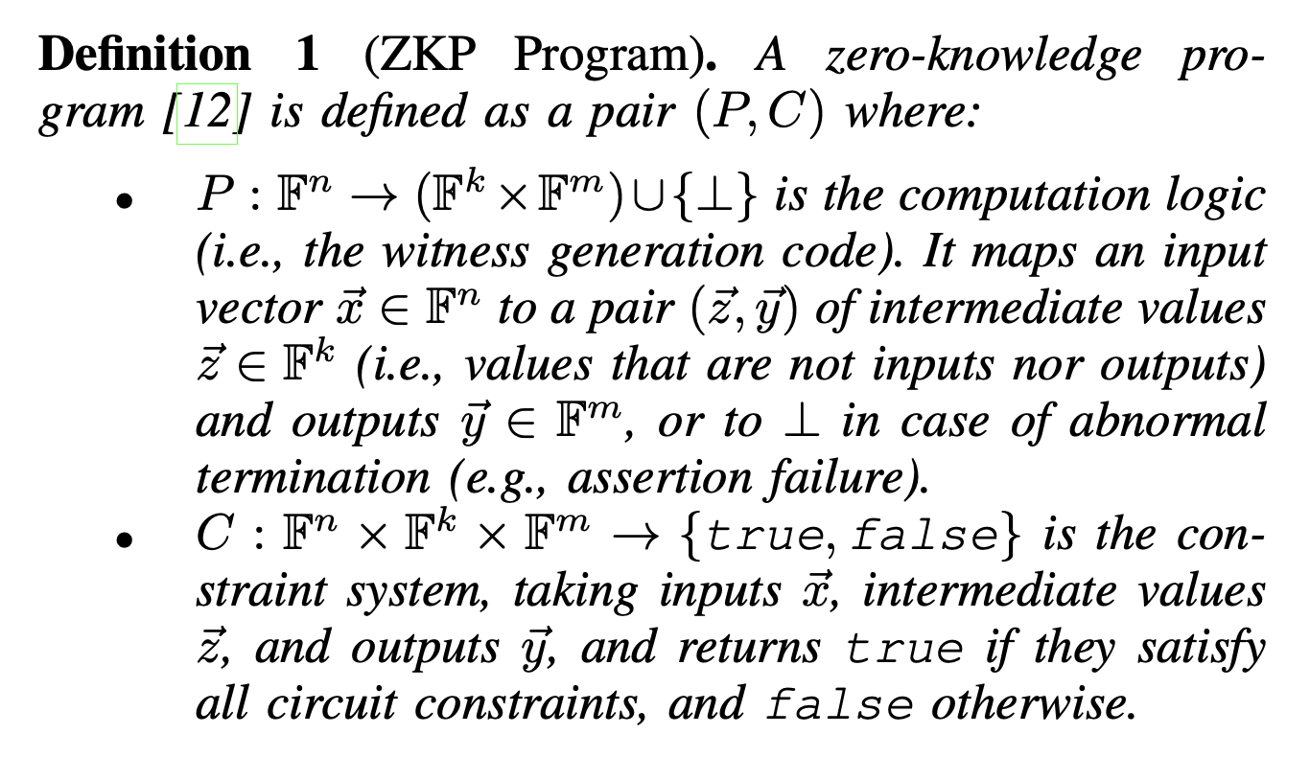
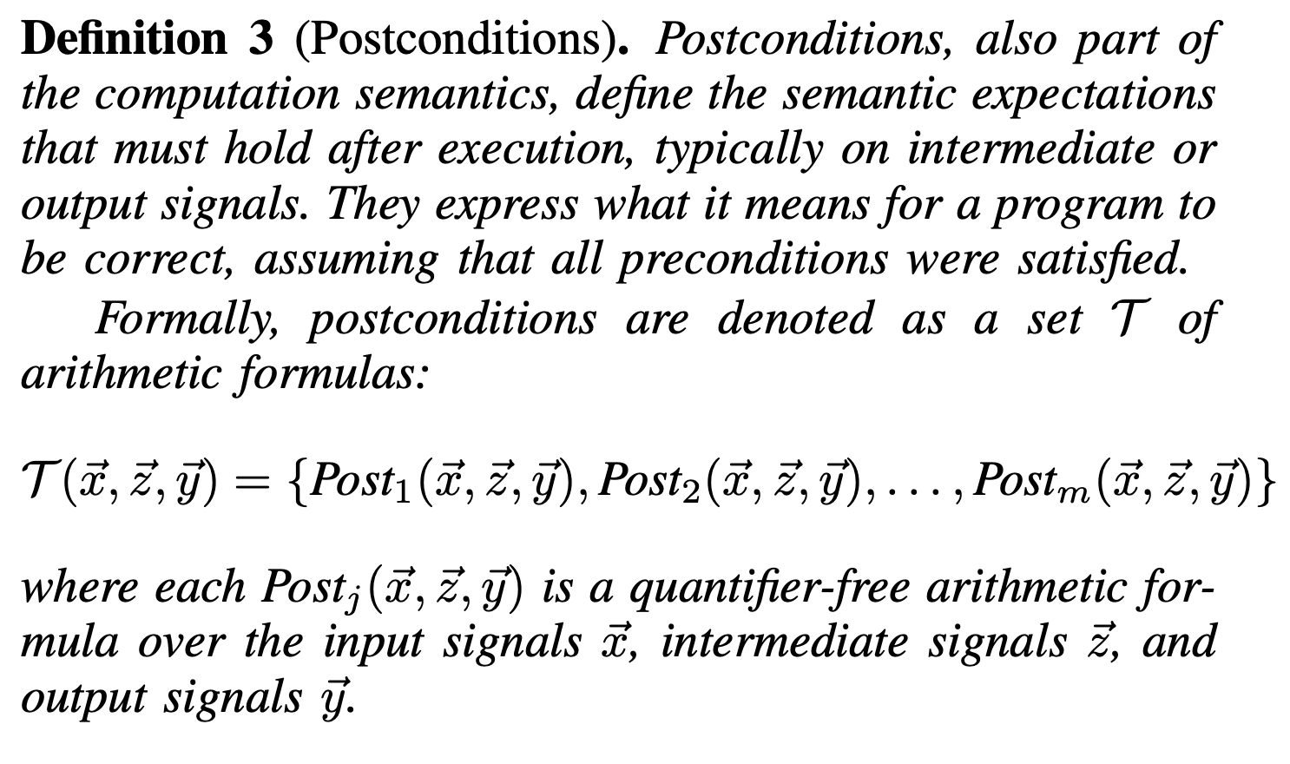
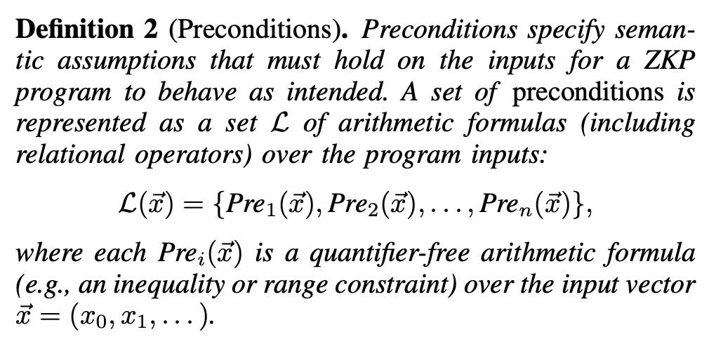
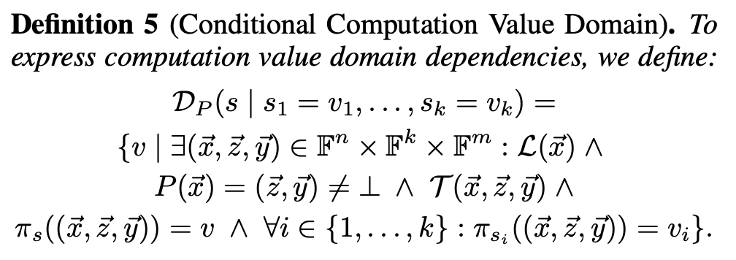
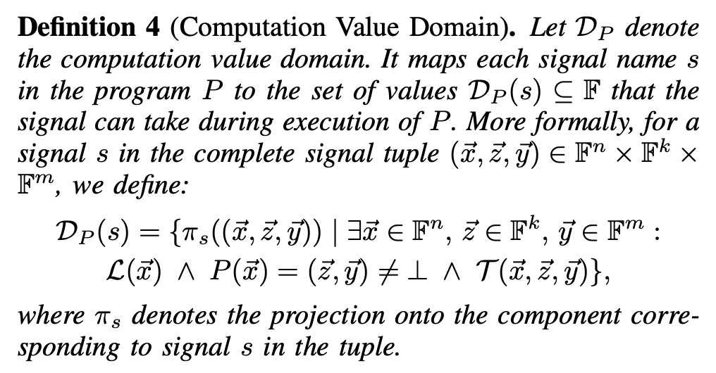
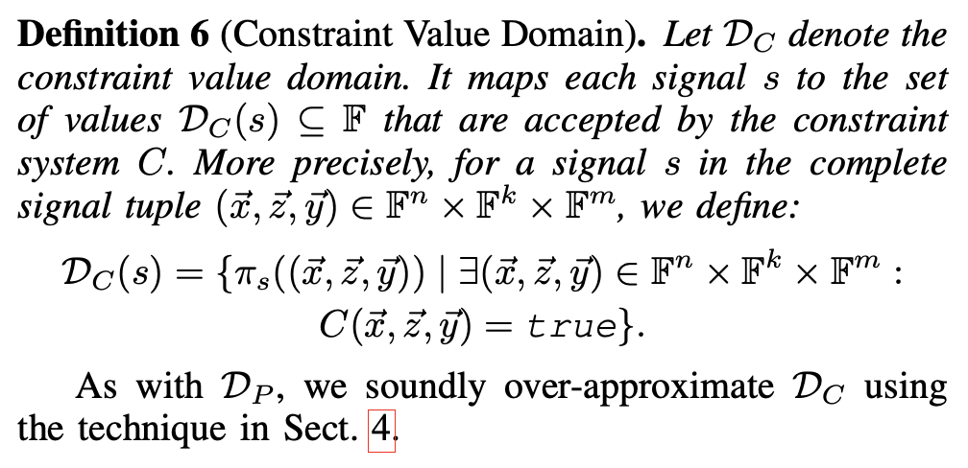
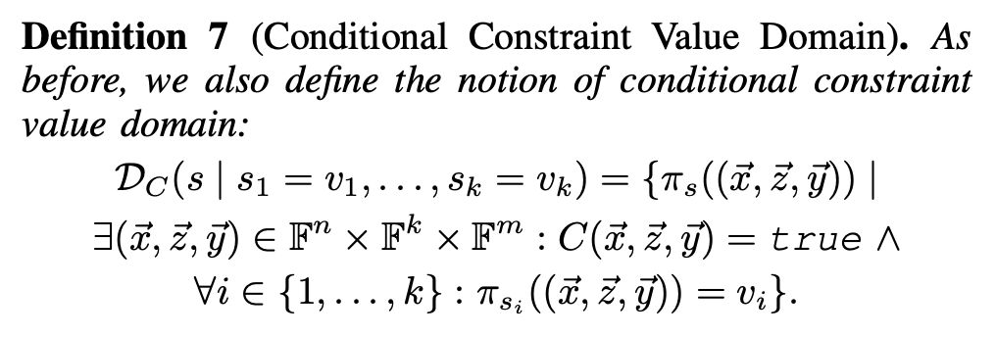
Domain Consistency Model (DCM)
28

Slide 36

DCM Example
ZKP PROGRAM
template Division() {
signal private input a;
signal input b;
signal output out;
out <-- a / b;
out * b === a;
}
COMPUTATIONS
CONSTRAINTS
out <-- a / b
out * b === a
a | b | out
a | b | out
29
Notes:
Can this set be produced by the program, and can this set of values be accepted by the verifier

Slide 37
DCM Example
ZKP PROGRAM
template Division() {
signal private input a;
signal input b;
signal output out;
out <-- a / b;
out * b === a;
}
COMPUTATIONS
CONSTRAINTS
out <-- a / b
out * b === a
a | b | out
4 | 2 | 2
a | b | out
4 | 2 | 2
30

Slide 38
DCM Example
ZKP PROGRAM
template Division() {
signal private input a;
signal input b;
signal output out;
out <-- a / b;
out * b === a;
}
COMPUTATIONS
CONSTRAINTS
out <-- a / b
out * b === a
a | b | out
4 | 2 | 2
2 | 1 | 2
a | b | out
4 | 2 | 2
2 | 1 | 2
31

Slide 39
DCM Example
ZKP PROGRAM
template Division() {
signal private input a;
signal input b;
signal output out;
out <-- a / b;
out * b === a;
}
COMPUTATIONS
CONSTRAINTS
out <-- a / b
out * b === a
a | b | out
4 | 2 | 2
2 | 1 | 2
0 | 0 | 5
a | b | out
4 | 2 | 2
2 | 1 | 2
0 | 0 | 5
32

Slide 40

DCM Example
ZKP PROGRAM
template Division() {
signal private input a;
signal input b;
signal output out;
out <-- a / b;
out * b === a;
}
COMPUTATIONS
CONSTRAINTS
out <-- a / b
out * b === a
a | b | out
4 | 2 | 2
2 | 1 | 2
0 | 0 | 5
0 | 0 | 6
a | b | out
4 | 2 | 2
2 | 1 | 2
0 | 0 | 5
0 | 0 | 6
33

Slide 41
DCM Example
ZKP PROGRAM
template Division() {
signal private input a;
signal input b;
signal output out;
out <-- a / b;
out * b === a;
}
COMPUTATIONS
CONSTRAINTS
out <-- a / b
out * b === a
a | b | out
4 | 2 | 2
2 | 1 | 2
0 | 0 | 5
0 | 0 | 6
Inconsistency!!
a | b | out
4 | 2 | 2
2 | 1 | 2
0 | 0 | 5
0 | 0 | 6
34
Notes:
IT IS IMPORTANT TO REALIZE HERE THAT THE ONLY WAY WE COULD HAVE KNOWN

Slide 42

DCM Example
ZKP PROGRAM
template Division() {
signal private input a;
signal input {nonZero} b;
signal output out;
out <-- a / b;
out * b === a;
}
COMPUTATIONS
CONSTRAINTS
out <-- a / b
out * b === a
a | b | out
4 | 2 | 2
2 | 1 | 2
0 | 0 | 5
0 | 0 | 6
Consistent
a | b | out
4 | 2 | 2
2 | 1 | 2
0 | 0 | 5
0 | 0 | 6
35

Slide 43
DCM Example
ZKP PROGRAM
template Division() {
signal private input a;
signal input {nonZero} b;
signal output out;
out <-- a / b;
out * b === a;
}
COMPUTATIONS
CONSTRAINTS
out <-- a / b
out * b === a
a | b | out
4 | 2 | 2
2 | 1 | 2
0 | 0 | 5
0 | 0 | 6
Consistent
a | b | out
4 | 2 | 2
2 | 1 | 2
0 | 0 | 5
0 | 0 | 6
36

Slide 44
template Division() {
signal private input a;
signal input {nonZero} b;
signal output out;
out <-- a / b;
out * b === a;
}
DCM Example
ZKP PROGRAM
template BadDivision() {
...
d <== Division(a, b);
out <== d.out;
}
COMPUTATIONS
CONSTRAINTS
out <-- a / b
out * b === a
a | b | out
4 | 2 | 2
2 | 1 | 2
0 | 0 | 5
0 | 0 | 6
Inconsistency!!
a | b | out
4 | 2 | 2
2 | 1 | 2
0 | 0 | 5
0 | 0 | 6
37

Slide 45
template Division() {
signal private input a;
signal input {nonZero} b;
signal output out;
out <-- a / b;
out * b === a;
}
DCM Example
ZKP PROGRAM
template BadDivision() {
...
d <== Division(a, b);
out <== d.out;
}
COMPUTATIONS
CONSTRAINTS
out <-- a / b
out * b === a
a | b | out
4 | 2 | 2
2 | 1 | 2
0 | 0 | 5
0 | 0 | 6
Inconsistency!!
a | b | out
4 | 2 | 2
2 | 1 | 2
0 | 0 | 5
0 | 0 | 6
38

Slide 46
template Division() {
signal private input a;
signal input {nonZero} b;
signal output out;
out <-- a / b;
out * b === a;
}
DCM Example
ZKP PROGRAM
template GoodDivision() {
...
NonZero(b);
d <== Division(a, b);
out <== d.out;
}
COMPUTATIONS
CONSTRAINTS
out <-- a / b
out * b === a
a | b | out
4 | 2 | 2
2 | 1 | 2
0 | 0 | 5
0 | 0 | 6
Inconsistency!!
a | b | out
4 | 2 | 2
2 | 1 | 2
0 | 0 | 5
0 | 0 | 6
39
Notes:
very simplified syntax

Slide 47
template Division() {
signal private input a;
signal input {nonZero} b;
signal output out;
out <-- a / b;
out * b === a;
}
DCM Example
ZKP PROGRAM
template GoodDivision() {
...
NonZero(b);
d <== Division(a, b);
out <== d.out;
}
COMPUTATIONS
CONSTRAINTS
out <-- a / b
out * b === a
a | b | out
4 | 2 | 2
2 | 1 | 2
0 | 0 | 5
0 | 0 | 6
Consistent
a | b | out
4 | 2 | 2
2 | 1 | 2
0 | 0 | 5
0 | 0 | 6
40

Slide 48
Prover-Verifier Mismatch Vulnerability Classes
Division by Zero
Arithmetic Overflows
Circuit Logic Assumptions
Special Signals
Out-of-Bounds Indexing
Conditionals with
Non-Binary Guard
41
Notes:
when the assumptions are violated

Slide 49
Contributions
Formalization: Domain Consistency Model (DCM)
Algorithm: Value Inference Engine
Implementation: Multi-Language Support
Evaluation: Discovery of Real-World Vulnerabilities
Notes:
How can we use this to detect vulnerabilities?
How can we turn this formalization into an algorithm?

Slide 50
Bug Detection Techniques
Formal Verification
Static Analysis
Slow, particularly for ZKPs
Precise
Example: via SMT solving
Fast
False positives
Example: abstract interpretation
45
Notes:
We have 2 worlds of verification techniques specifically for the ZKP world
Formally checks whether the program satisfies certain properties

Slide 51
Bug Detection Techniques
Formal Verification
Static Analysis
Slow, particularly for ZKPs
Precise
Example: via SMT solving
Fast
False positives
Example: abstract interpretation
45
Notes:
We have 2 worlds of verification techniques specifically for the ZKP world
Formally checks whether the program satisfies certain properties

Slide 52
(Over-)Approximating the DCM
Naively implementing the DCM
→ reasoning about all possible values of variables
→ iterating over p possible values per variable
→ too slow!
21888242871839275222246405745257275088548364400416034343698204186575808495617
Inconsistency!!
a | b | out
4 | 2 | 2
2 | 1 | 2
0 | 0 | 5
0 | 0 | 6
a | b | out
4 | 2 | 2
2 | 1 | 2
0 | 0 | 5
0 | 0 | 6
43
Notes:
naively
not achievable, at least not in an efficient manner

Slide 53
template Division() {
signal private input a;
signal input {nonZero} b;
signal output out;
out <-- a / b;
out * b === a;
}
(Over-)Approximating the DCM
template BadDivision() {
...
d <== Division(a, b);
out <== d.out;
}
out <-- a / b
out * b === a
a | b | out
4 | 2 | 2
2 | 1 | 2
0 | 0 | 5
0 | 0 | 6
a | b | out
4 | 2 | 2
2 | 1 | 2
0 | 0 | 5
0 | 0 | 6
44

Slide 54
template Division() {
signal private input a;
signal input {nonZero} b;
signal output out;
out <-- a / b;
out * b === a;
}
Insight #1: Signal Tags
template BadDivision() {
...
d <== Division(a, b);
out <== d.out;
}
out <-- a / b
out * b === a
a | b | out
maxval: 15 | nonZero | /
a | b | out
4 | 2 | 2
2 | 1 | 2
0 | 0 | 5
0 | 0 | 6
It suffices to only keep track of signal tags on the prover side!
45
Notes:
This provides us with a nice summary of what an honest prover is supposed to do

Slide 55
template Division() {
signal private input a;
signal input {nonZero} b;
signal output out;
out <-- a / b;
out * b === a;
}
Insight #2: Abstract Values
template BadDivision() {
...
d <== Division(a, b);
out <== d.out;
}
out <-- a / b
out * b === a
a | b | out
maxval: 15 | nonZero | /
a | b | out
[0, 15] | [0, 5] | [1, 10]
It suffices to only keep track of signal tags on the prover side!
46

Slide 56
template Division() {
signal private input a;
signal input {nonZero} b;
signal output out;
out <-- a / b;
out * b === a;
}
Insight #2: Abstract Values
template BadDivision() {
...
d <== Division(a, b);
out <== d.out;
}
out <-- a / b
out * b === a
a | b | out
maxval: 15 | nonZero | /
a | b | out
[0, 15] | [0, 5] | [1, 10]
It suffices to only keep track of signal tags on the prover side!
It suffices to approximate the values on the verifier side!
47
Notes:
instead of going over all possible values and asking: does the verifier accept this set? does the verifier accept that set?
the only question ...
The signal tags we can egt them from the program, or the developer can provide externally

Slide 57
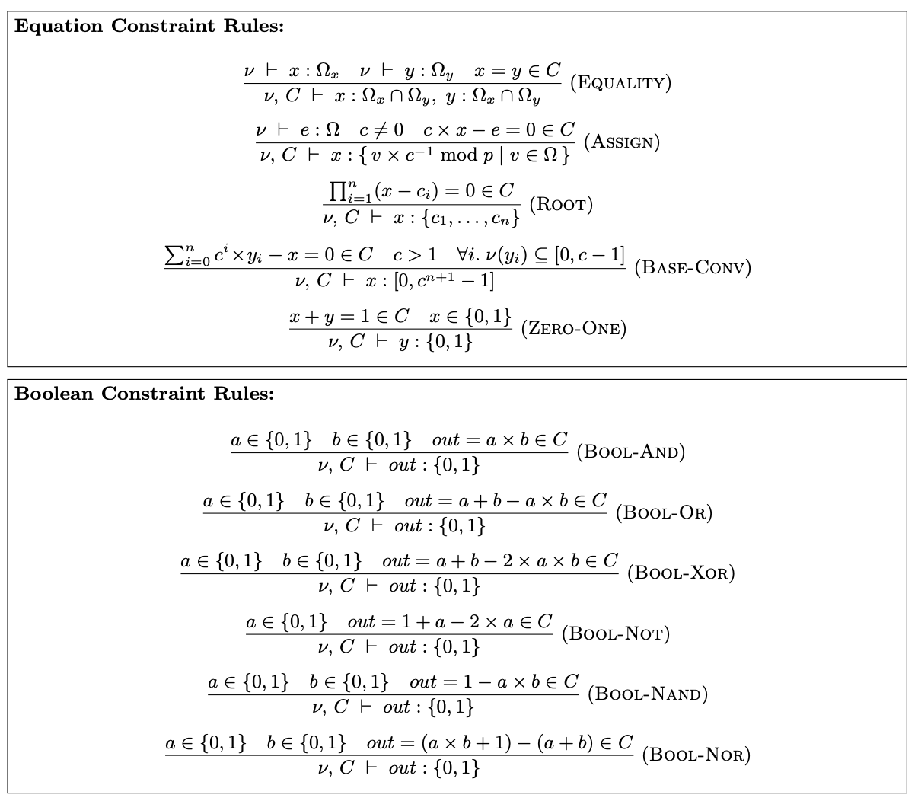
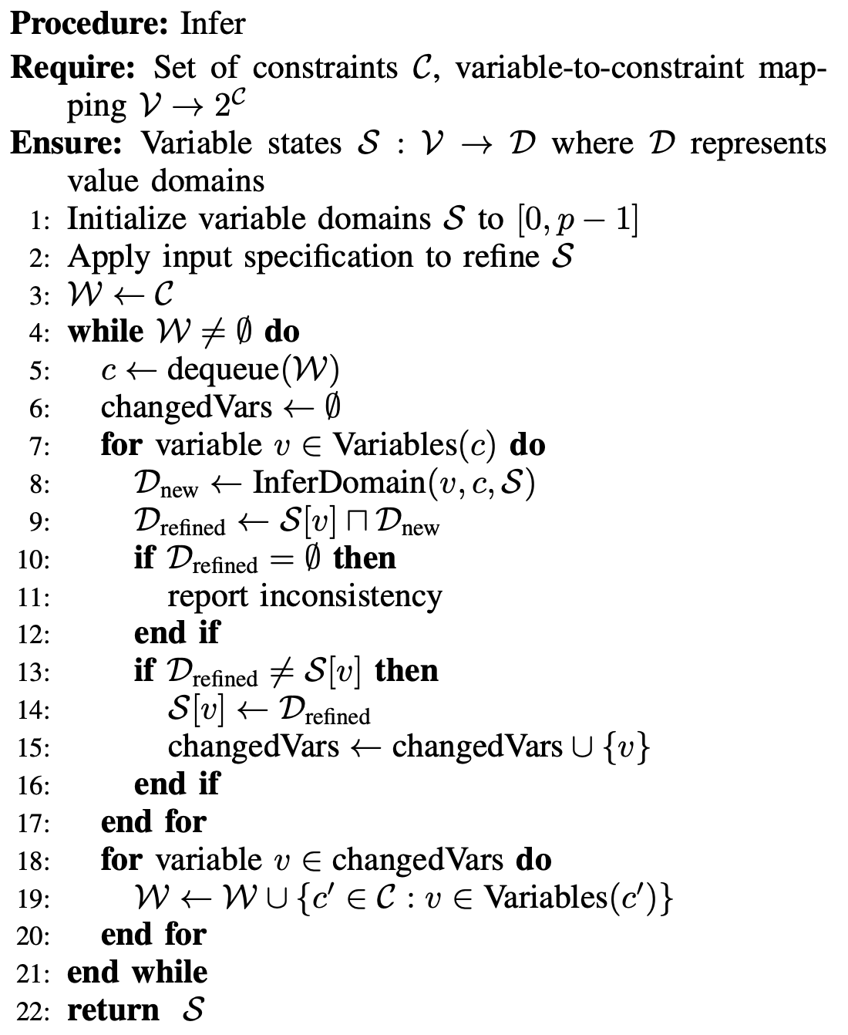
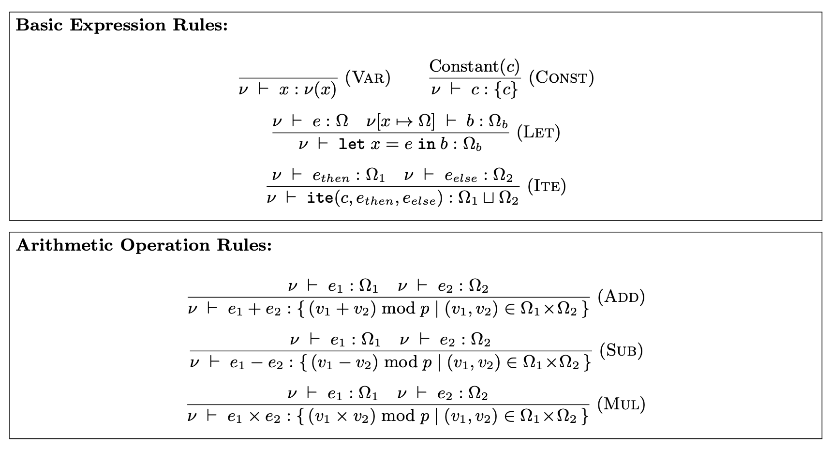
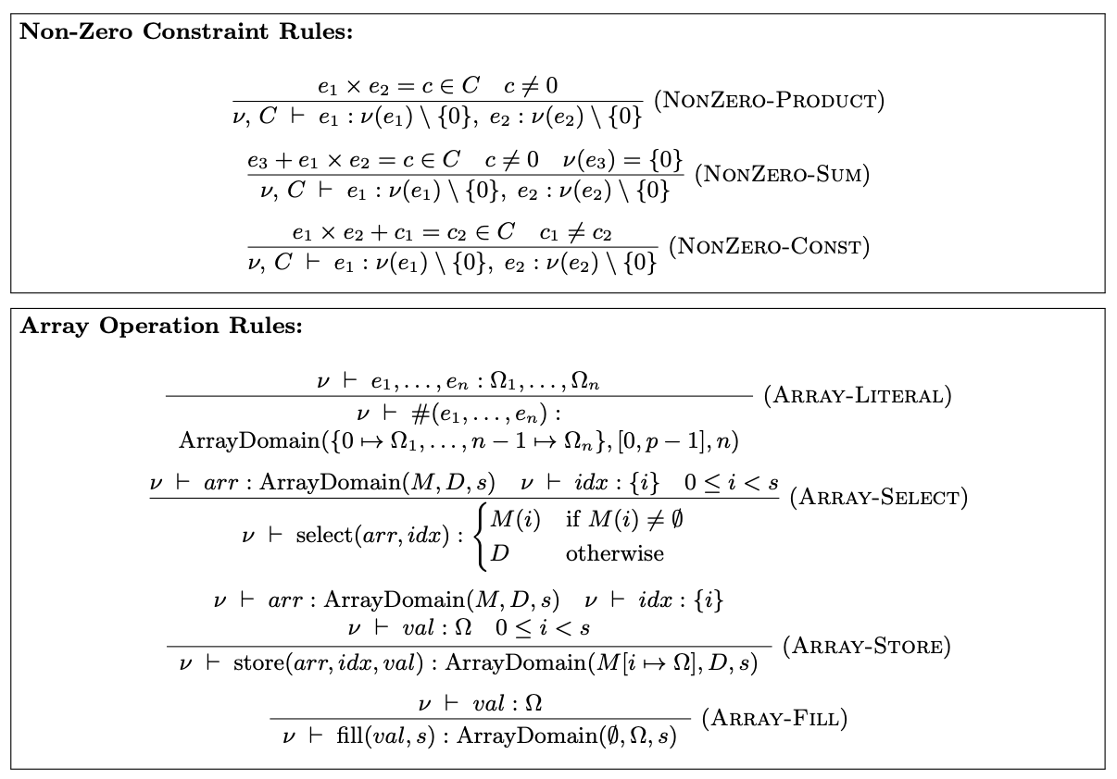
Inference Rules
x * (x – 2) === 0
x ∈ [0,2]
[Shankara Pailoor et al., PLDI 2023]
48
Notes:
Rules that exploit the fact that there are many re-occuring patterns in ZKP programs, and so these rules define that oh if you see this pattern, then you can refine the values of variables that occur in that pattern.
---
To give a very simple example
THAT's WHAT THE VERIFIER WILL ACCEPT
NONZERO EXAMPLE
---
Took these rules from the literature and extended them
---
Our algorithm keeps applying these rules, until a fixpoint is reached where we can derive no further value information.

Slide 58
template Division() {
signal private input a;
signal input {nonZero} b;
signal output out;
out <-- a / b;
out * b === a;
}
Insight #2: Abstract Values
template BadDivision() {
...
d <== Division(a, b);
out <== d.out;
}
out <-- a / b
out * b === a
a | b | out
maxval: 15 | nonZero | /
a | b | out
[0, 15] | [0, 5] | [1, 10]
It suffices to only keep track of signal tags on the prover side!
It suffices to approximate the values on the verifier side!
49
Notes:
instead of going over all possible values and asking: does the verifier accept this set? does the verifier accept that set?
the only question ...
The signal tags we can egt them from the program, or the developer can provide externally

Slide 59
Contributions
Formalization: Domain Consistency Model (DCM)
Algorithm: Value Inference Engine
Implementation: Multi-Language Support
Evaluation: Discovery of Real-World Vulnerabilities

Slide 60
ZKP Languages
[Alex Ozdemir, ZK HACK]
51

Slide 61

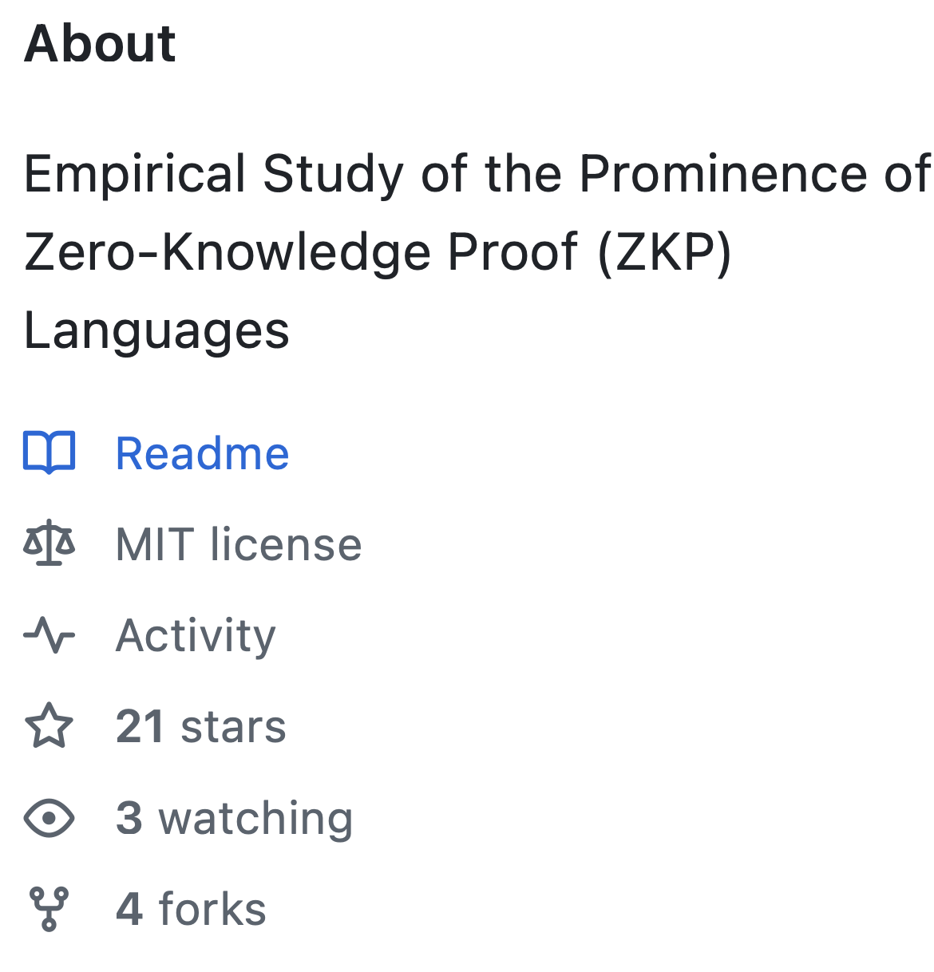
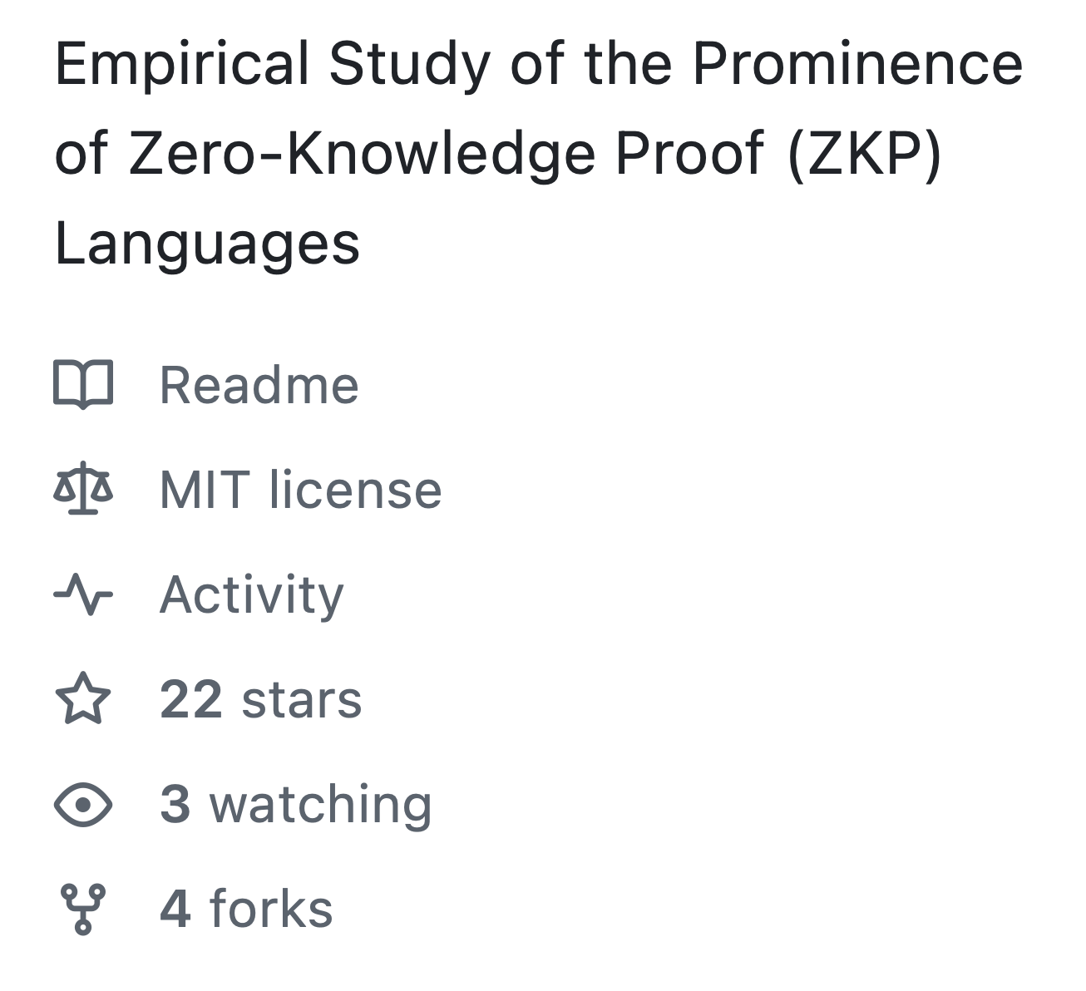
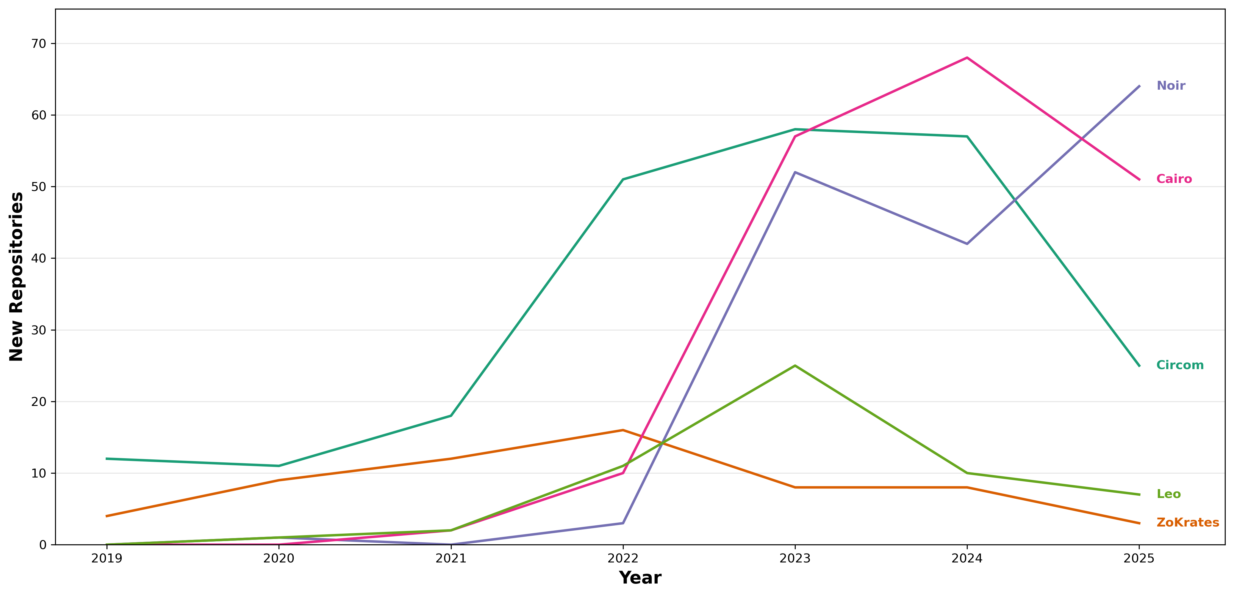
Multi-Language Support?
[Alex Ozdemir et al., IEEE S&P 2022]
Intermediate Representation!
Computations
Constraints
52
Notes:
From this we could see we need to support
the question: HOW?
CirC, which is a shared compiler infrastructure for cryptographic tools like ZKPs which for example translates ZKP programs to different output formats for different goals . But what is important for us, is that it operates over an intermediate representation, the CirC IR. This means that if we build our tool for this IR, we support all the languages that it supports. Because all you have to do
like R1CS (used for proof systems), SMT (used for verification and bug-finding), and ILP (used for optimization)

Slide 62
Contributions
Formalization: Domain Consistency Model (DCM)
Algorithm: Value Inference Engine
Implementation: Multi-Language Support
Evaluation: Discovery of Real-World Vulnerabilities

Slide 63
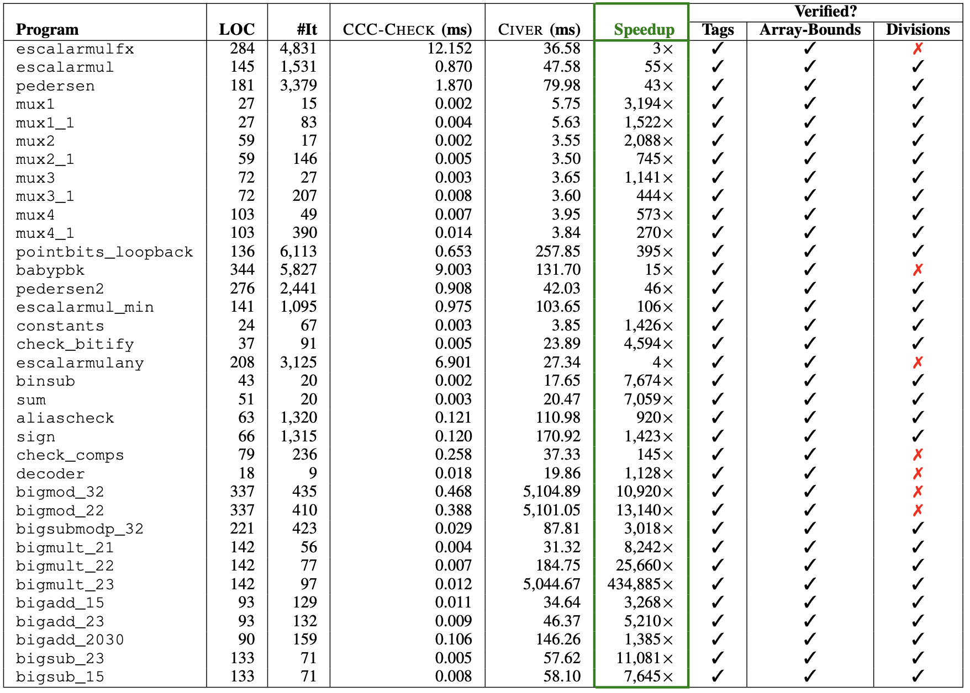
How effective is our approach in verifying tagged programs?
Comparison of time and effectiveness against SMT-based approach (CIVER)
35 tagged benchmark programs
On average two orders of magnitude faster
div-by-zero false positives due to over-approximation
54
Notes:
TIME-OUT

Slide 64


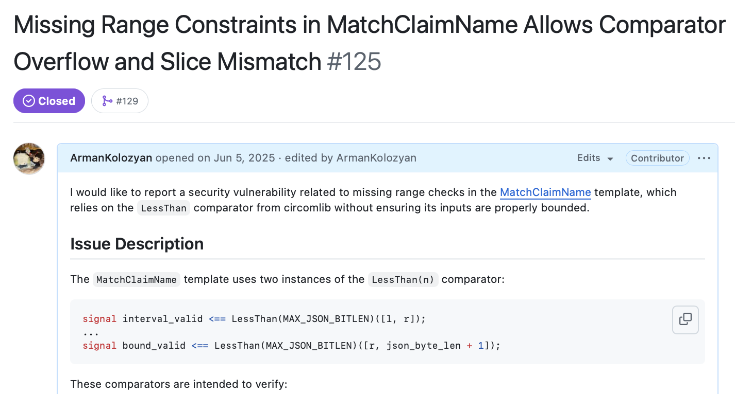
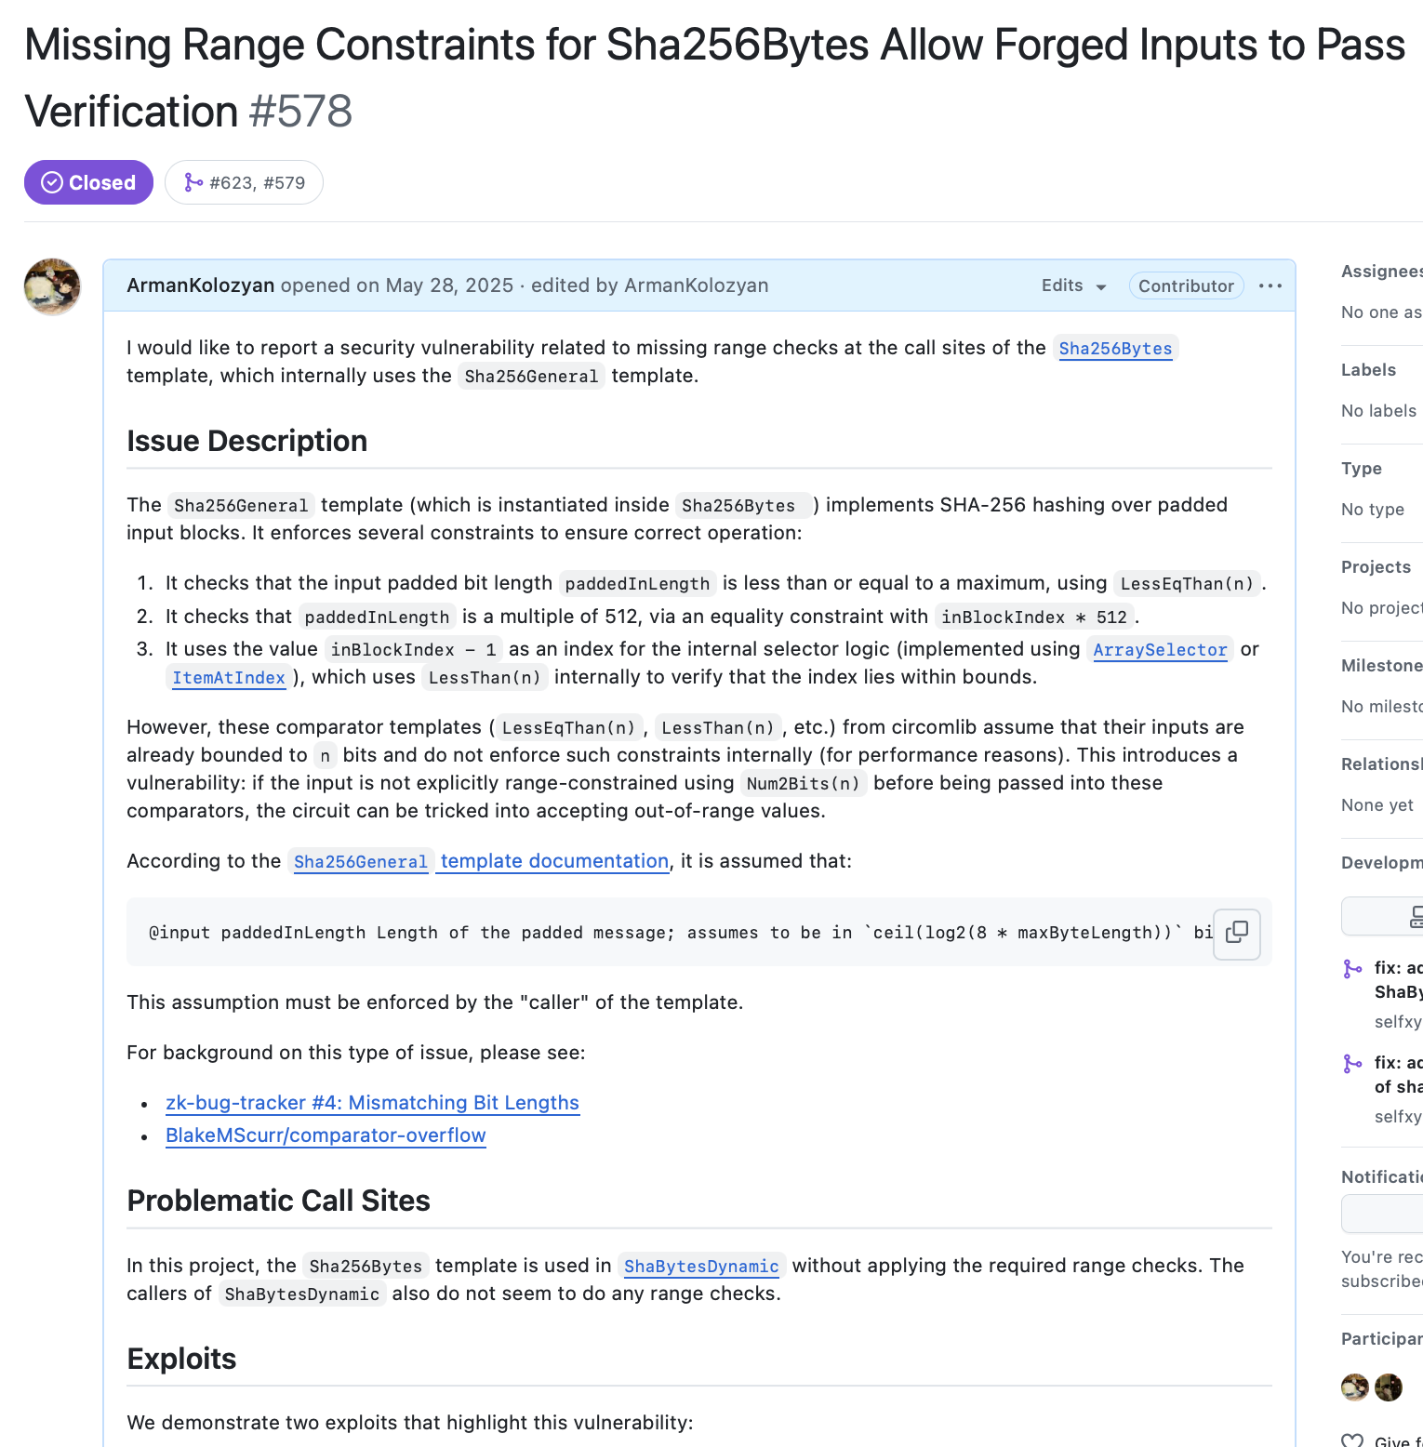
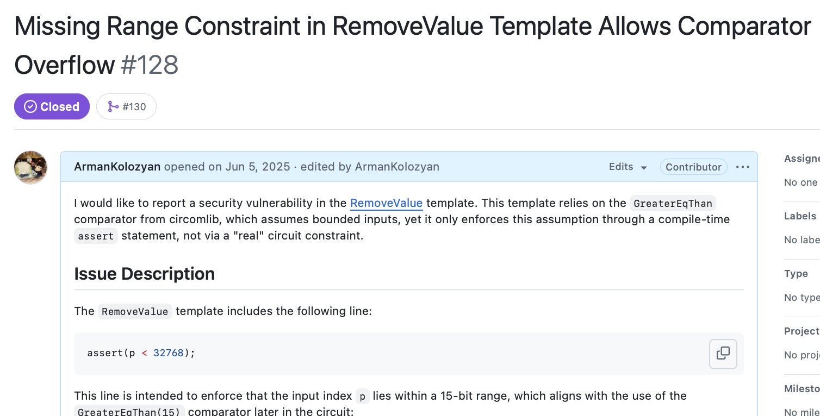
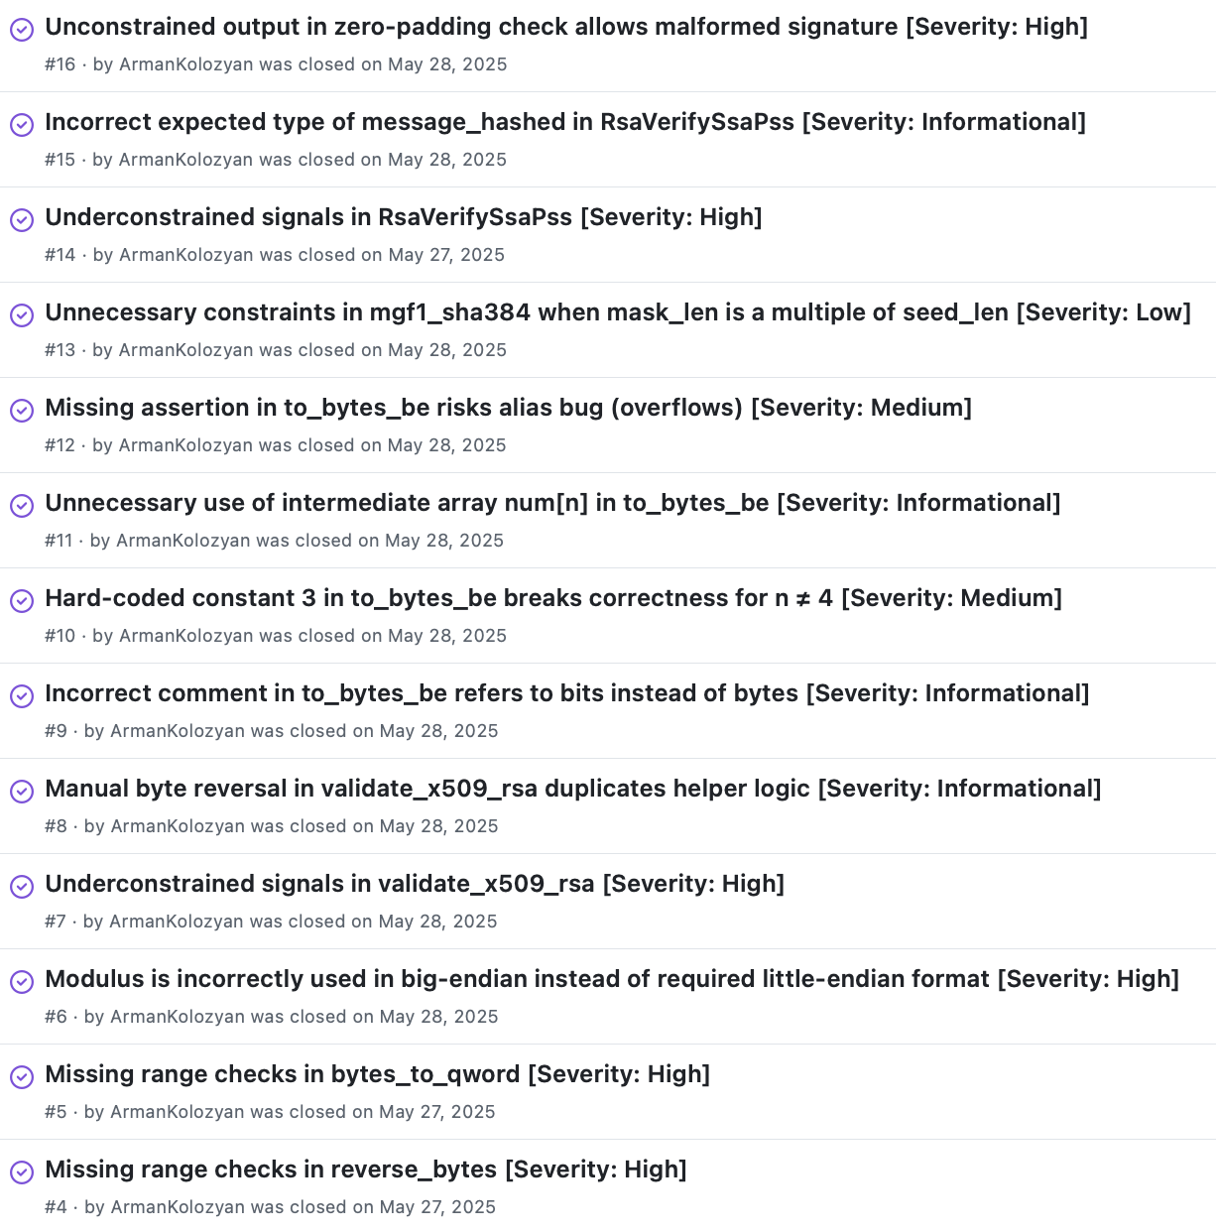
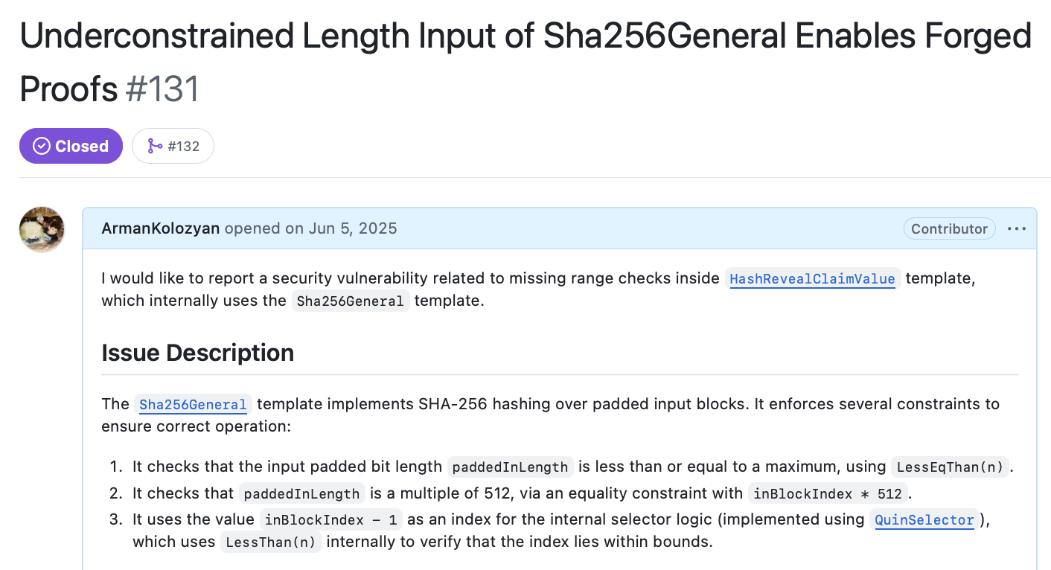
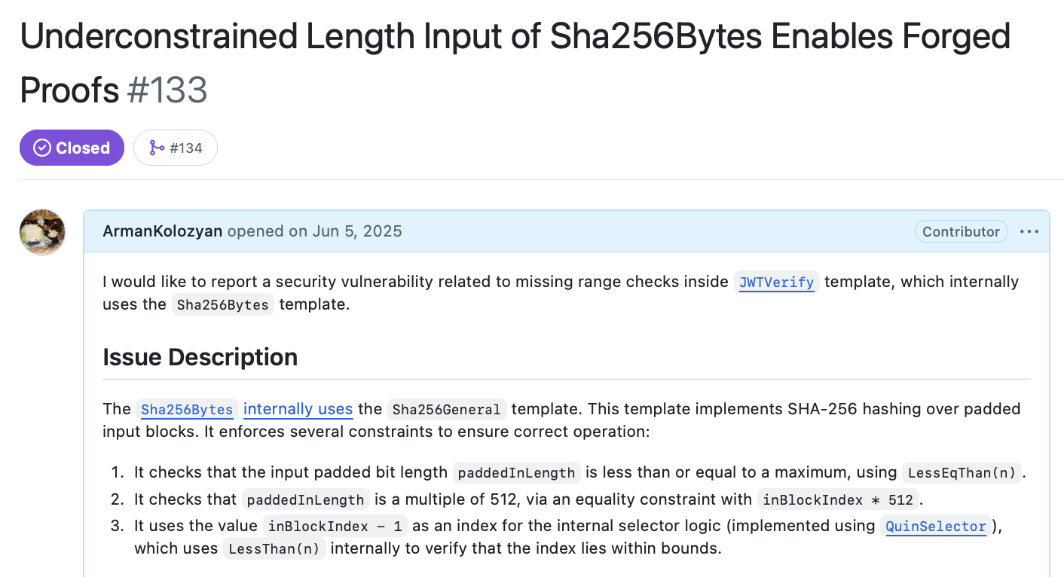
How prevalent are these vulnerabilities in real-world programs?
55
Notes:
Possession of valid mobile driver’s license
Third party TEE is legitimate
Missed durring the audit by a major ZKP auditing company

Slide 65






Future Work
Key Directions
Improve Usability
SoK Study
Better tooling & abstractions
Build Secure
Systems
Systematic review of
ZK security landscape
Leverage AI
AI-assisted tooling
ZK-based systems we can actually trust
Proof Assistants
Formal verification in Lean
56
Notes:
Possession of valid mobile driver’s license
Third party TEE is legitimate
Missed durring the audit by a major ZKP auditing company

Slide 66
Future Work
Key Directions
Improve Usability
SoK Study
Better tooling & abstractions
Build Secure
Systems
Systematic review of
ZK security landscape
Leverage AI
AI-assisted tooling
ZK-based systems we can actually trust
Proof Assistants
Formal verification in Lean
57
Notes:
Possession of valid mobile driver’s license
Third party TEE is legitimate
Missed durring the audit by a major ZKP auditing company

Slide 67




Language-Agnostic Detection of Bugs in ZKP Programs
Arman Kolozyan (arman@kolozyan.com)
Computation-Constraint Mismatches!
ZKP programs often fail to enforce (implicit) assumptions.
out <-- a / b
out * b === a
Specifications (e.g., signal tags)
Abstract values
There is a need for language-agnostic bug detectors.
Intermediate Representations!
58
Notes:
The specifications can help you to already get a rough idea of what an honest prover is expected to do and similar approximation can be done on the verification side via abstract interpretation.
more recently another IR, which highlights the significance of this contribution
if you would like to dive deeper into the technical details
happy to take on any questions

