Slide 1
Language-Agnostic Detection of Bugs in ZKP Programs
Arman Kolozyan: MPI-SP
9 May 2026

Slide 2

ZKP Application Example
4

Slide 3

ZKP Application Example
Programmable!
5

Slide 4






ZKP Pipeline
PROVER
template Name() {
signal private input a;
signal input b;
signal output out;
...
}
PROOF
IDEA
ZKP PROGRAM
VERIFIER
9
Notes:
So you have a certain idea, for example a program to verify the nationality of someone. Then what you have to is write z ZKP program. This is not a regular program because you have to write it in a ZKP-specific programming language, and that comes with its own syntax for example …
From this program,
Verifier will check whether this proof is valid, or in other words whether it was generated from this program, without seeing the private inputs.
Example: the prover will get the date of brith from the passport, calculate the age, ..
The verifier will check whether you correctly took the date of brith from the passport, correctly calculated the age, ...

Slide 5


ZKP Pipeline
PROVER
template Name() {
signal private input a;
signal input b;
signal output out;
...
}
PROOF
IDEA
ZKP PROGRAM
VERIFIER
10

Slide 6
ZKP Pipeline
PROVER
template Name() {
signal private input a;
signal input b;
signal output out;
...
}
PROOF
IDEA
ZKP PROGRAM
VERIFIER
11
Notes:
It then gives the necessary stuff for the prover to generate a proof, and for the verifier to check the proof.

Slide 7
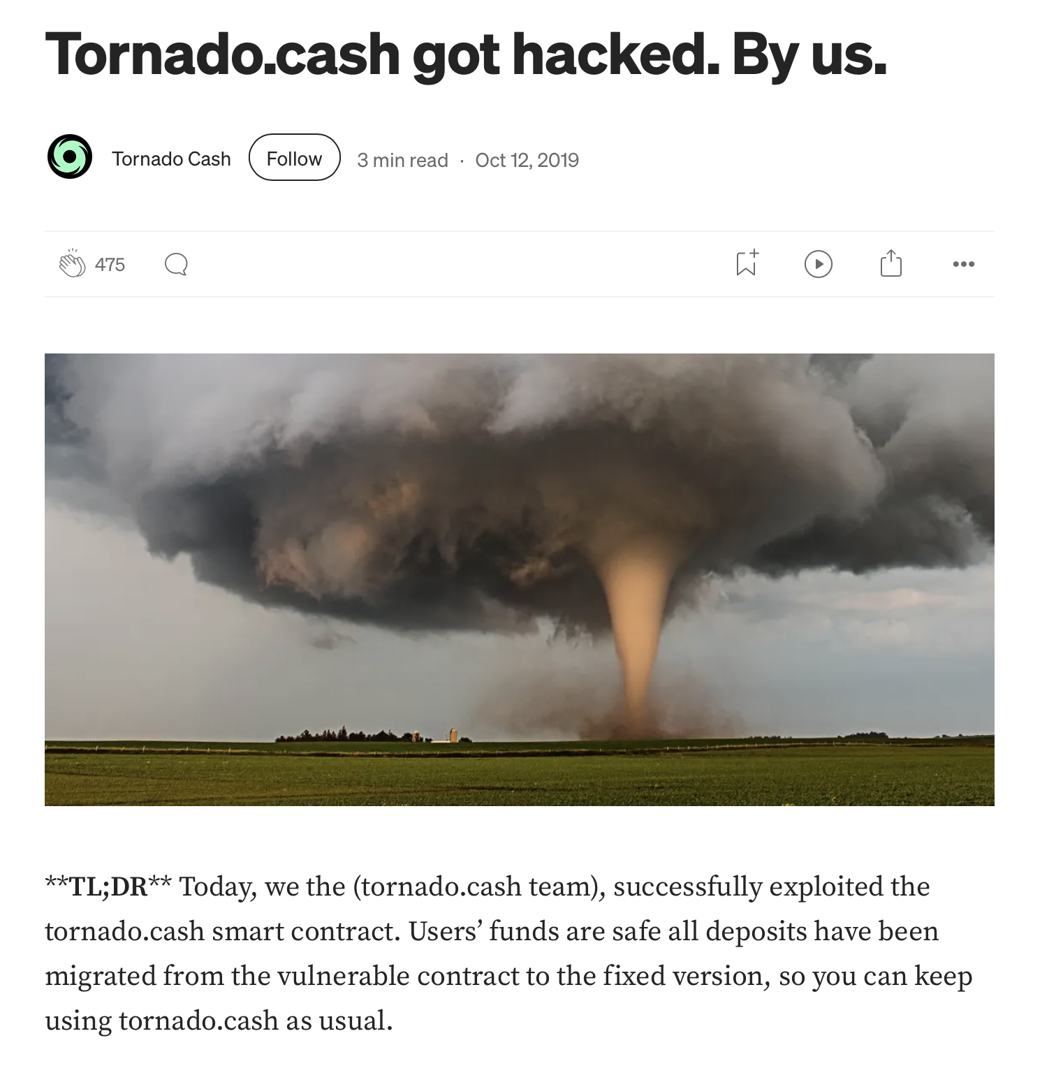
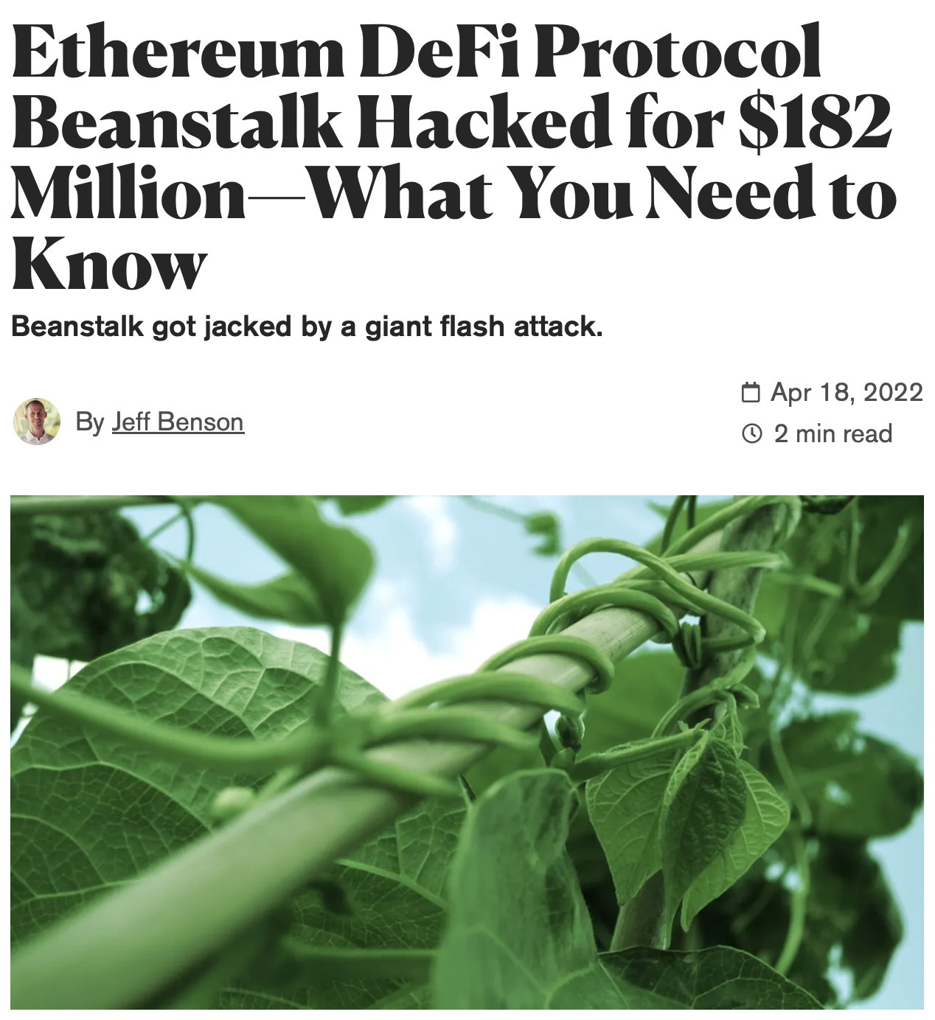
Bugs in ZKPs
Bugs in blockchain software are extremely costly
12
Notes:
ZKPs are used in blockchain context
“small” bugs can then have very severe consequences
attackers could create fake coins and it could lead to the loss of millions of dollars

Slide 8
Contributions
Formalization: Domain Consistency Model (DCM)
Algorithm: Value Inference Engine
Implementation: Multi-Language Support
Evaluation: Discovery of Real-World Vulnerabilities
Notes:
Which we call ... In which we formalized
What is a ZKP program? When is such a program correct, and more importantly when is it not correct? What are the then types of vulnerabilities in this context?
Then we turned that formalization into an algorithm for efficiently detecting vulnerabilities
Then when the time came to implement this algorithm, we investigated whether there is a need to support multiple ZKP languages, and if so, how we could achieve multi-language support.
And finally, as part of the evaluation, we discovered several real-world vulnerabilities that can only be captured by our formal model, that I would like to briefly discuss
But to understand these first contributions, we need some background

Slide 9
Background

Slide 10
ZKP Pipeline
template Name() {
signal private input a;
signal input b;
signal output out;
...
}
IDEA
ZKP PROGRAM
15
Notes:
BECAUSE IF WE GO BACK TO WHERE WE LEFT OFF, I MENTIONED

Slide 11
ZKP Pipeline
out <-- a * b
template Name() {
signal private input a;
signal input b;
signal output out;
out <-- a * b;
out === a * b;
}
IDEA
ZKP PROGRAM
out === a * b
16
Notes:
It is important that they match, in the sense that the verifier needs to check exactly the things an honest prover is expected to do. So that if we have a cheater who creates fakes proofs, we can detect.

Slide 12
ZKP Pipeline
out <-- a * b
template Name() {
signal private input a;
signal input b;
signal output out;
out <-- a * b;
out === a * b;
}
a: 4
b: 2
out: 8
IDEA
8 === 4 * 2?
ZKP PROGRAM
out === a * b
17

Slide 13

ZKP Pipeline
out <-- a * b
template Name() {
signal private input a;
signal input b;
signal output out;
out <-- a * b;
out === a * b;
}
a: 4
b: 2
out: 8
IDEA
8 === 4 * 2?
ZKP PROGRAM
out === a * b
18
Notes:
Now you might wonder: you are exactly dpong the same thing twice, so why does the programmer

Slide 14
Allowed Operations in ZKPs
Prover (computations):
  Addition (+)
  Multiplication (*)
  Assignment (<--)
  And much more (/, <, ...)
Verifier (constraints):
  Addition (+)
  Multiplication (*)
  Equality (===)
19

Slide 15

Allowed Operations in ZKPs
Prover (computations):
  Addition (+)
  Multiplication (*)
  Assignment (<--)
  And much more (/, <, ...)
Verifier (constraints):
  Addition (+)
  Multiplication (*)
  Equality (===)
20
Notes:
THAT MAGIC HAS PUT RESTRICTIONS ON US
This is problematic, causes complexities, because ...

Slide 16
Semantic Mismatches
out <-- a / b
template Name() {
signal private input a;
signal input b;
signal output out;
out <-- a / b;
}
a: 4
b: 2
out: 2
IDEA
ZKP PROGRAM
?????????????
21

Slide 17
Semantic Mismatches
out <-- a / b
template Name() {
signal private input a;
signal input b;
signal output out;
out <-- a / b;
out * b === a;
}
a: 4
b: 2
out: 2
IDEA
2 * 2 === 4?
ZKP PROGRAM
out * b === a
22

Slide 18

Semantic Mismatches
out <-- a / b
template Name() {
signal private input a;
signal input b;
signal output out;
out <-- a / b;
out * b === a;
}
a: 4
b: 0
out: 2
Division by Zero!
IDEA
ZKP PROGRAM
out * b === a
23
Notes:
If we look back to why this happened (more expressiveness)
What the developer forgot to do

Slide 19

Semantic Mismatches
out <-- a / b
template Name() {
signal private input a;
signal input b;
signal output out;
out <-- a / b;
out * b === a;
}
a: 4
b: 0
out: 2
a: 0
b: 0
out: 5
Division by Zero!
IDEA
5 * 0 === 0?
ZKP PROGRAM
out * b === a
24
Notes:
what we are missing here

Slide 20
Signal Tags
out <-- a / b
template Name() {
signal private input a;
signal input {nonZero} b;
signal output out;
out <-- a / b;
out * b === a;
}
a: 4
b: 0
out: 2
Reason: performance
Many such assumptions in
library templates
Compiler does not verify
a: 0
b: 0
out: 5
IDEA
5 * 0 === 0?
ZKP PROGRAM
out * b === a
25
Notes:
CALLER
minimize #constraints
if we would have

Slide 21
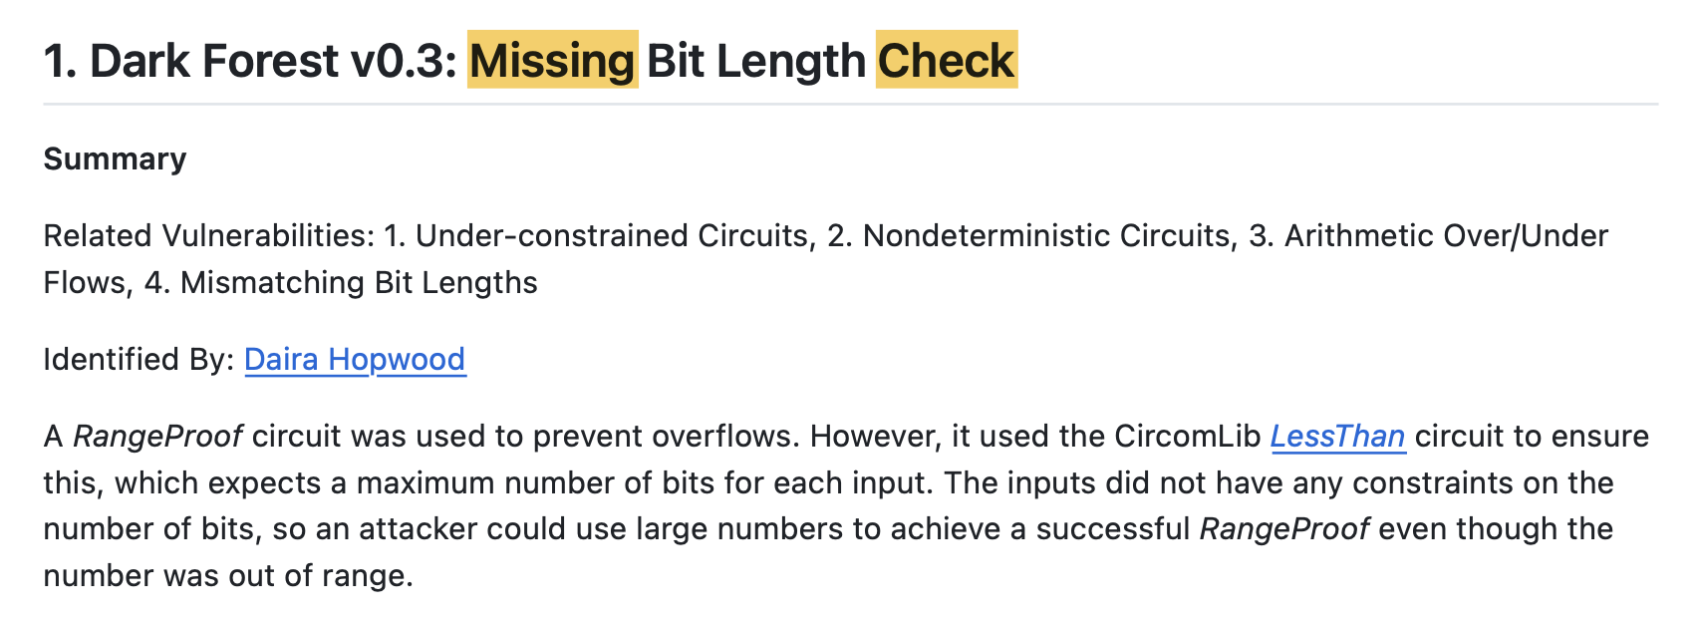
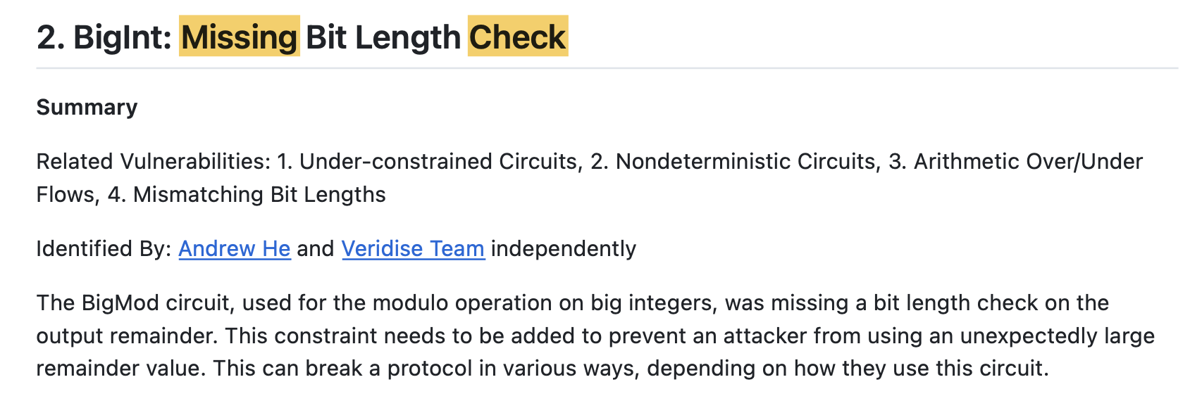
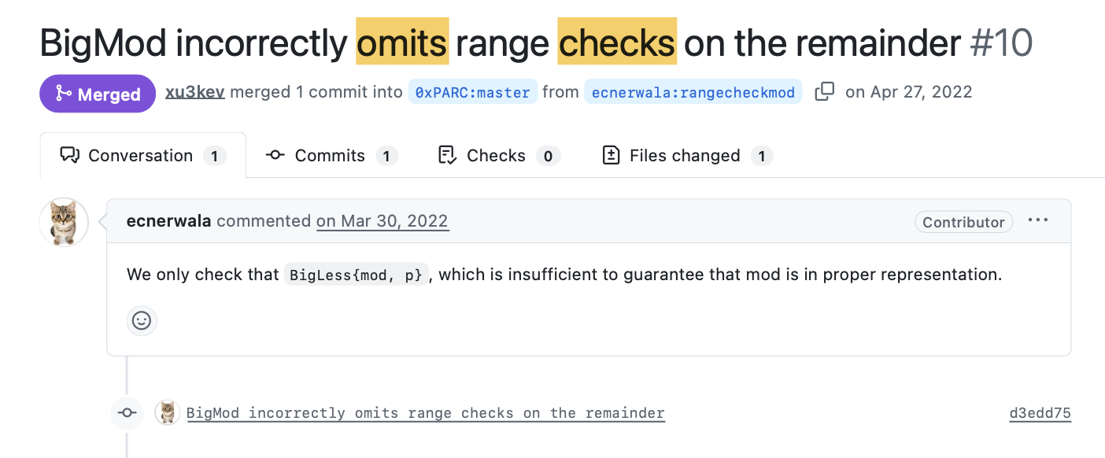
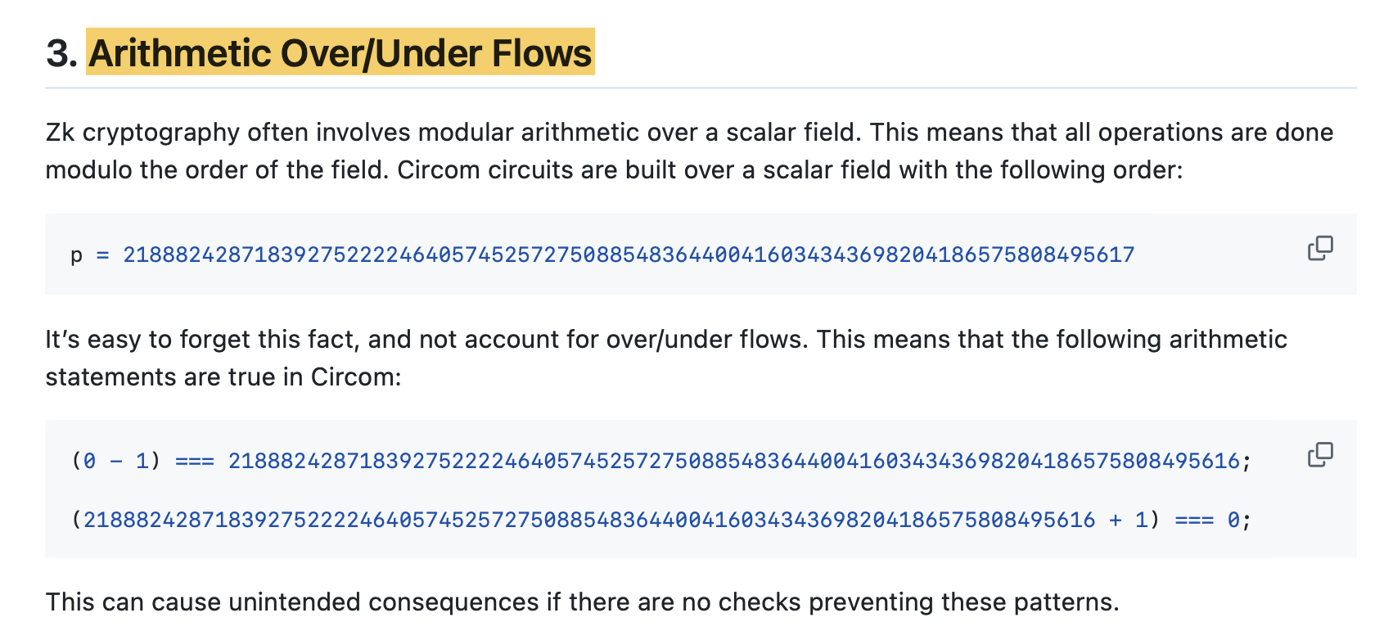
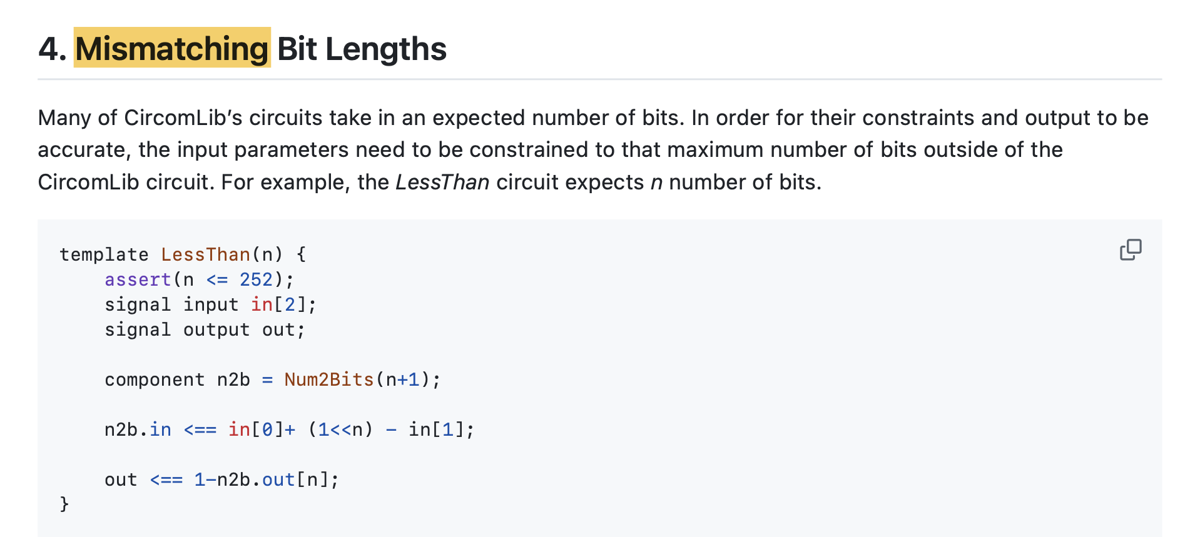
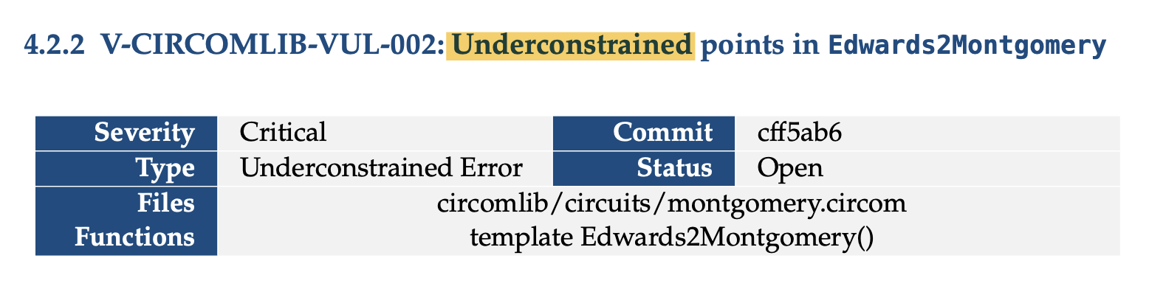
Bug Examples
[0xPARC/zk-bug-tracker, GitHub]
26
Notes:
AND SUCH BUGS HAVE BEEN IDENTIFIED IN THE WILD. HERE ARE EXAMPLES FROM BUG REPORTS and BUG TRACKERS DESCRIBING VULNERABILITIES IN THE CONTEXT OF ZKP LANGUAGES.

Slide 22
Contributions
Formalization: Domain Consistency Model (DCM)
Algorithm: Value Inference Engine
Implementation: Multi-Language Support
Evaluation: Discovery of Real-World Vulnerabilities
Notes:
Formal definitions and proofs in the paper

Slide 23

DCM Example
ZKP PROGRAM
template Division() {
signal private input a;
signal input b;
signal output out;
out <-- a / b;
out * b === a;
}
COMPUTATIONS
CONSTRAINTS
out <-- a / b
out * b === a
a | b | out
a | b | out
31
Notes:
Can this set be produced by the program, and can this set of values be accepted by the verifier

Slide 24
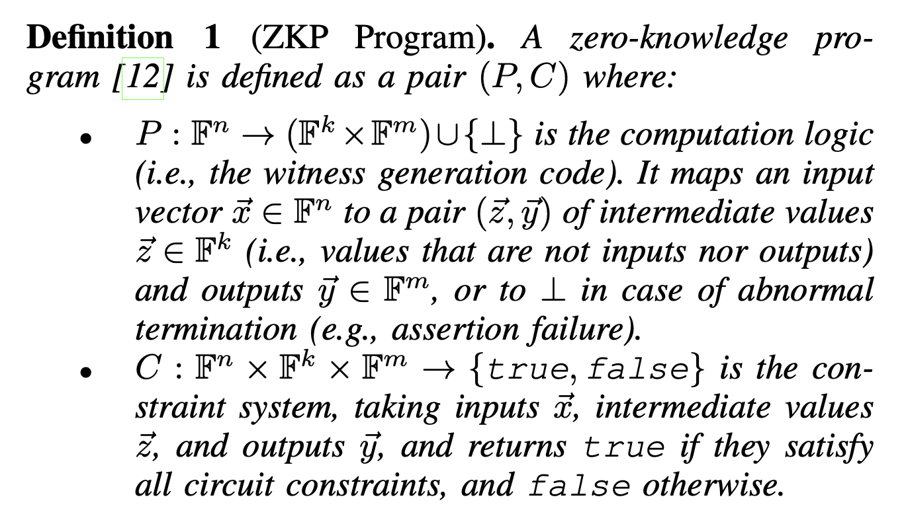
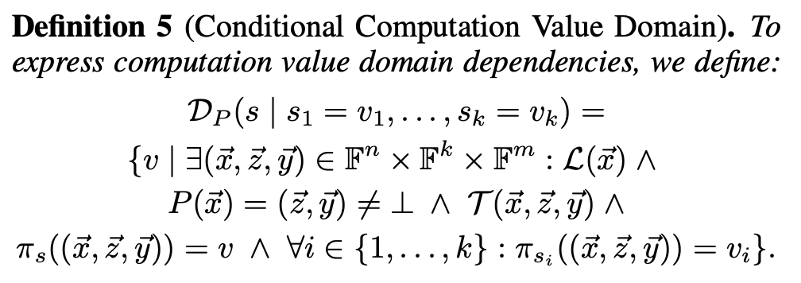
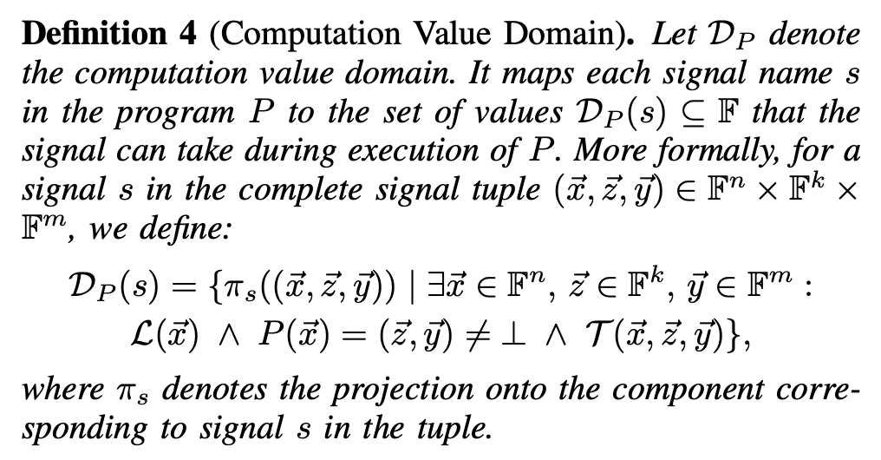
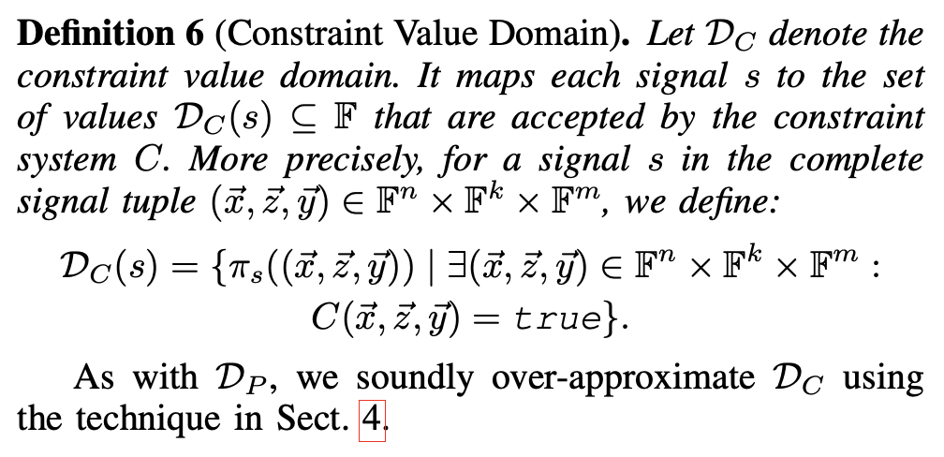
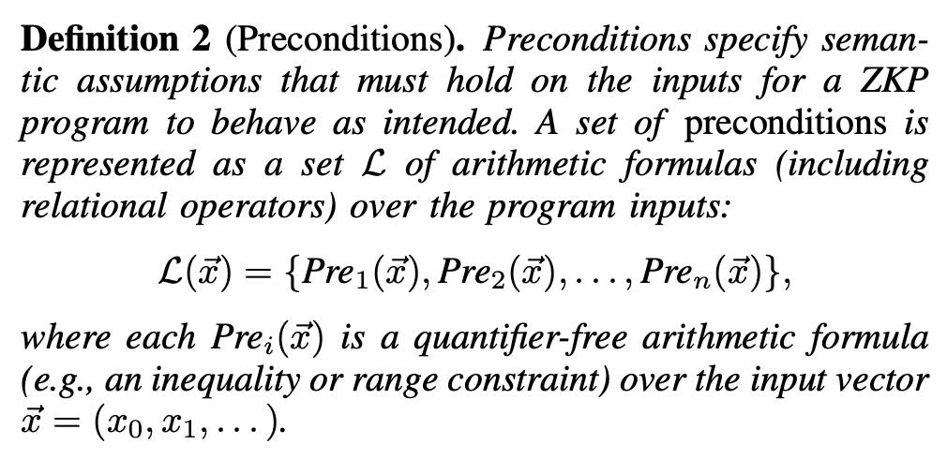
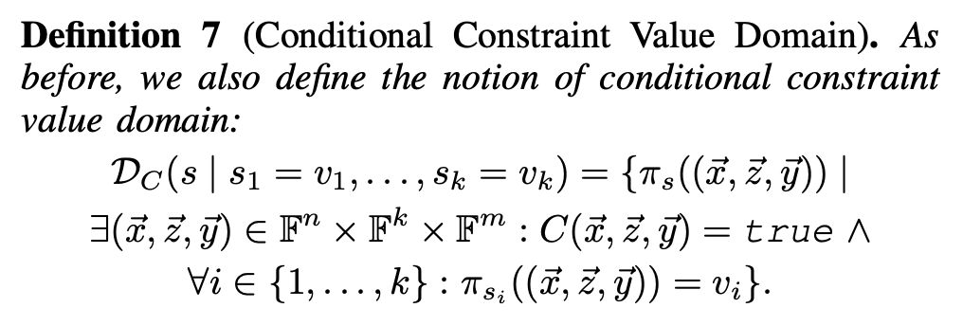
Domain Consistency Model (DCM)
31
Notes:
Can this set be produced by the program, and can this set of values be accepted by the verifier

Slide 25
DCM Example
ZKP PROGRAM
template Division() {
signal private input a;
signal input b;
signal output out;
out <-- a / b;
out * b === a;
}
COMPUTATIONS
CONSTRAINTS
out <-- a / b
out * b === a
a | b | out
4 | 2 | 2
a | b | out
4 | 2 | 2
32

Slide 26
DCM Example
ZKP PROGRAM
template Division() {
signal private input a;
signal input b;
signal output out;
out <-- a / b;
out * b === a;
}
COMPUTATIONS
CONSTRAINTS
out <-- a / b
out * b === a
a | b | out
4 | 2 | 2
2 | 1 | 2
a | b | out
4 | 2 | 2
2 | 1 | 2
33

Slide 27
DCM Example
ZKP PROGRAM
template Division() {
signal private input a;
signal input b;
signal output out;
out <-- a / b;
out * b === a;
}
COMPUTATIONS
CONSTRAINTS
out <-- a / b
out * b === a
a | b | out
4 | 2 | 2
2 | 1 | 2
0 | 0 | 5
a | b | out
4 | 2 | 2
2 | 1 | 2
0 | 0 | 5
34

Slide 28

DCM Example
ZKP PROGRAM
template Division() {
signal private input a;
signal input b;
signal output out;
out <-- a / b;
out * b === a;
}
COMPUTATIONS
CONSTRAINTS
out <-- a / b
out * b === a
a | b | out
4 | 2 | 2
2 | 1 | 2
0 | 0 | 5
0 | 0 | 6
a | b | out
4 | 2 | 2
2 | 1 | 2
0 | 0 | 5
0 | 0 | 6
35

Slide 29
DCM Example
ZKP PROGRAM
template Division() {
signal private input a;
signal input b;
signal output out;
out <-- a / b;
out * b === a;
}
COMPUTATIONS
CONSTRAINTS
out <-- a / b
out * b === a
a | b | out
4 | 2 | 2
2 | 1 | 2
0 | 0 | 5
0 | 0 | 6
Inconsistency!!
a | b | out
4 | 2 | 2
2 | 1 | 2
0 | 0 | 5
0 | 0 | 6
36
Notes:
IT IS IMPORTANT TO REALIZE HERE THAT THE ONLY WAY WE COULD HAVE KNOWN

Slide 30

DCM Example
ZKP PROGRAM
template Division() {
signal private input a;
signal input {nonZero} b;
signal output out;
out <-- a / b;
out * b === a;
}
COMPUTATIONS
CONSTRAINTS
out <-- a / b
out * b === a
a | b | out
4 | 2 | 2
2 | 1 | 2
0 | 0 | 5
0 | 0 | 6
Consistent
a | b | out
4 | 2 | 2
2 | 1 | 2
0 | 0 | 5
0 | 0 | 6
37

Slide 31
DCM Example
ZKP PROGRAM
template Division() {
signal private input a;
signal input {nonZero} b;
signal output out;
out <-- a / b;
out * b === a;
}
COMPUTATIONS
CONSTRAINTS
out <-- a / b
out * b === a
a | b | out
4 | 2 | 2
2 | 1 | 2
0 | 0 | 5
0 | 0 | 6
Consistent
a | b | out
4 | 2 | 2
2 | 1 | 2
0 | 0 | 5
0 | 0 | 6
38

Slide 32
template Division() {
signal private input a;
signal input {nonZero} b;
signal output out;
out <-- a / b;
out * b === a;
}
DCM Example
ZKP PROGRAM
template BadDivision() {
...
d <== Division(a, b);
out <== d.out;
}
COMPUTATIONS
CONSTRAINTS
out <-- a / b
out * b === a
a | b | out
4 | 2 | 2
2 | 1 | 2
0 | 0 | 5
0 | 0 | 6
Inconsistency!!
a | b | out
4 | 2 | 2
2 | 1 | 2
0 | 0 | 5
0 | 0 | 6
39

Slide 33
template Division() {
signal private input a;
signal input {nonZero} b;
signal output out;
out <-- a / b;
out * b === a;
}
DCM Example
ZKP PROGRAM
template BadDivision() {
...
d <== Division(a, b);
out <== d.out;
}
COMPUTATIONS
CONSTRAINTS
out <-- a / b
out * b === a
a | b | out
4 | 2 | 2
2 | 1 | 2
0 | 0 | 5
0 | 0 | 6
Inconsistency!!
a | b | out
4 | 2 | 2
2 | 1 | 2
0 | 0 | 5
0 | 0 | 6
40

Slide 34
template Division() {
signal private input a;
signal input {nonZero} b;
signal output out;
out <-- a / b;
out * b === a;
}
DCM Example
ZKP PROGRAM
template BadDivision() {
...
NonZero(b);
d <== Division(a, b);
out <== d.out;
}
COMPUTATIONS
CONSTRAINTS
out <-- a / b
out * b === a
a | b | out
4 | 2 | 2
2 | 1 | 2
0 | 0 | 5
0 | 0 | 6
Inconsistency!!
a | b | out
4 | 2 | 2
2 | 1 | 2
0 | 0 | 5
0 | 0 | 6
41
Notes:
very simplified syntax

Slide 35
template Division() {
signal private input a;
signal input {nonZero} b;
signal output out;
out <-- a / b;
out * b === a;
}
DCM Example
ZKP PROGRAM
template GoodDivision() {
...
NonZero(b);
d <== Division(a, b);
out <== d.out;
}
COMPUTATIONS
CONSTRAINTS
out <-- a / b
out * b === a
a | b | out
4 | 2 | 2
2 | 1 | 2
0 | 0 | 5
0 | 0 | 6
Consistent
a | b | out
4 | 2 | 2
2 | 1 | 2
0 | 0 | 5
0 | 0 | 6
42

Slide 36
Semantic Mismatch Vulnerability Classes
Division by Zero
Arithmetic Overflows
Circuit Logic Assumptions
Special Signals
Out-of-Bounds Indexing
Conditionals with
Non-Binary Guard
43
Notes:
when the assumptions are violated

Slide 37
Contributions
Formalization: Domain Consistency Model (DCM)
Algorithm: Value Inference Engine
Implementation: Multi-Language Support
Evaluation: Discovery of Real-World Vulnerabilities
Notes:
How can we use this to detect vulnerabilities?
How can we turn this formalization into an algorithm?

Slide 38
(Over-)Approximating the DCM
Inconsistency!!
a | b | out
4 | 2 | 2
2 | 1 | 2
0 | 0 | 5
0 | 0 | 6
a | b | out
4 | 2 | 2
2 | 1 | 2
0 | 0 | 5
0 | 0 | 6
Instantiating the DCM
→ reasoning about all possible values of variables
→ iterating over p possible values
→ too slow!
21888242871839275222246405745257275088548364400416034343698204186575808495617
46
Notes:
naively

Slide 39
template Division() {
signal private input a;
signal input {nonZero} b;
signal output out;
out <-- a / b;
out * b === a;
}
(Over-)Approximating the DCM
template BadDivision() {
...
d <== Division(a, b);
out <== d.out;
}
out <-- a / b
out * b === a
a | b | out
4 | 2 | 2
2 | 1 | 2
0 | 0 | 5
0 | 0 | 6
a | b | out
4 | 2 | 2
2 | 1 | 2
0 | 0 | 5
0 | 0 | 6
47

Slide 40
template Division() {
signal private input a;
signal input {nonZero} b;
signal output out;
out <-- a / b;
out * b === a;
}
Insight #1: Signal Tags
template BadDivision() {
...
d <== Division(a, b);
out <== d.out;
}
out <-- a / b
out * b === a
a | b | out
maxval: 15 | nonZero | /
a | b | out
4 | 2 | 2
2 | 1 | 2
0 | 0 | 5
0 | 0 | 6
It suffices to only keep track of signal tags on the computation side!
48
Notes:
This provides us with a nice summary of what an honest prover is supposed to do

Slide 41
template Division() {
signal private input a;
signal input {nonZero} b;
signal output out;
out <-- a / b;
out * b === a;
}
Insight #2: Abstract Values
template BadDivision() {
...
d <== Division(a, b);
out <== d.out;
}
out <-- a / b
out * b === a
a | b | out
maxval: 15 | nonZero | /
a | b | out
[0, 15] | [0, 5] | [1, 10]
It suffices to only keep track of signal tags on the computation side!
49

Slide 42
template Division() {
signal private input a;
signal input {nonZero} b;
signal output out;
out <-- a / b;
out * b === a;
}
Insight #2: Abstract Values
template BadDivision() {
...
d <== Division(a, b);
out <== d.out;
}
out <-- a / b
out * b === a
a | b | out
maxval: 15 | nonZero | /
a | b | out
[0, 15] | [0, 5] | [1, 10]
It suffices to only keep track of signal tags on the computation side!
It suffices to approximate the values on the constraint side!
50
Notes:
instead of going over all possible values and asking: does the verifier accept this set? does the verifier accept that set?
the only question ...
The signal tags we can egt them from the program, or the developer can provide externally

Slide 43
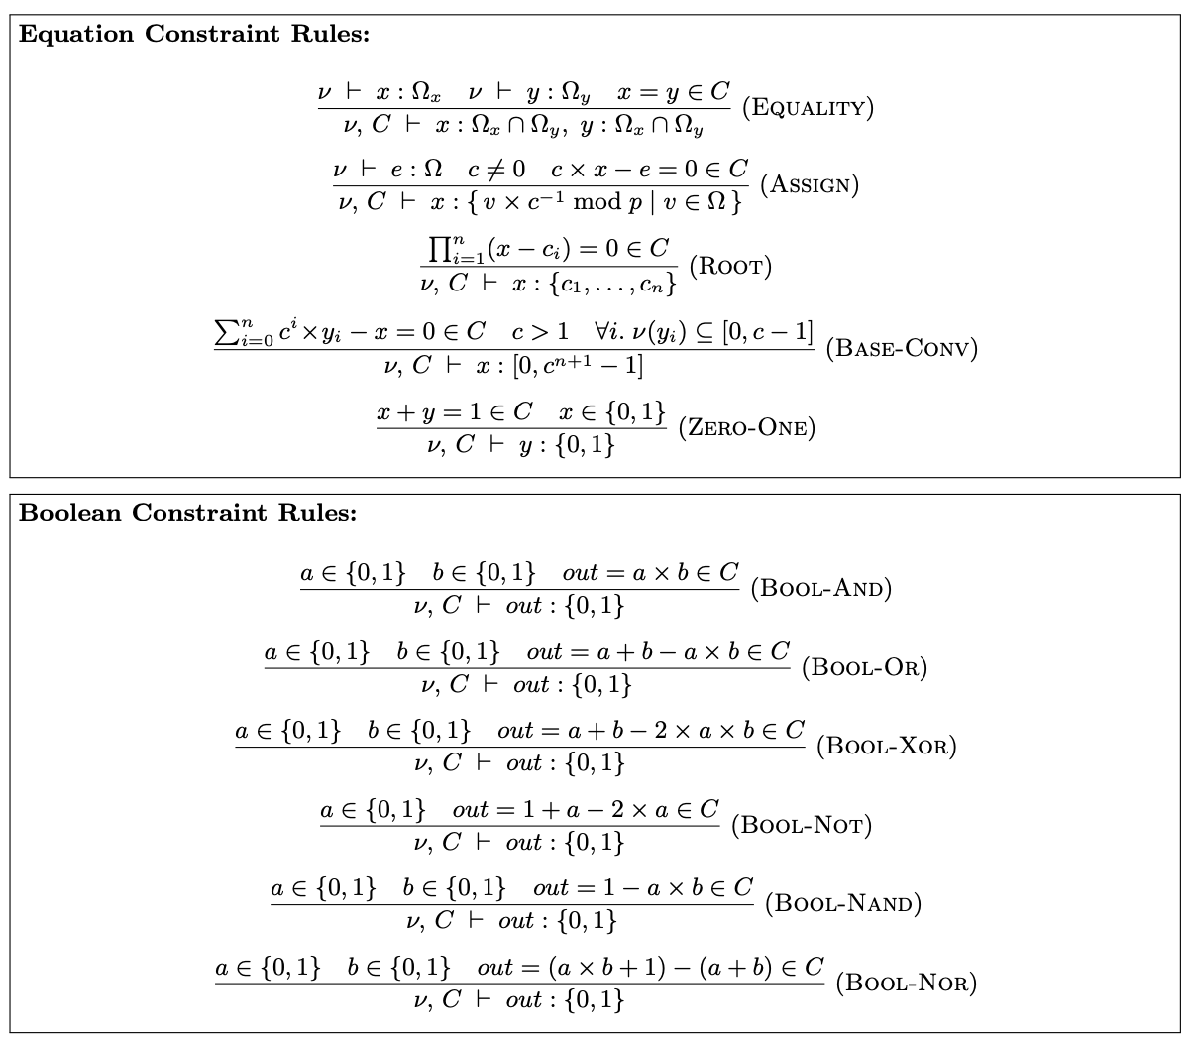
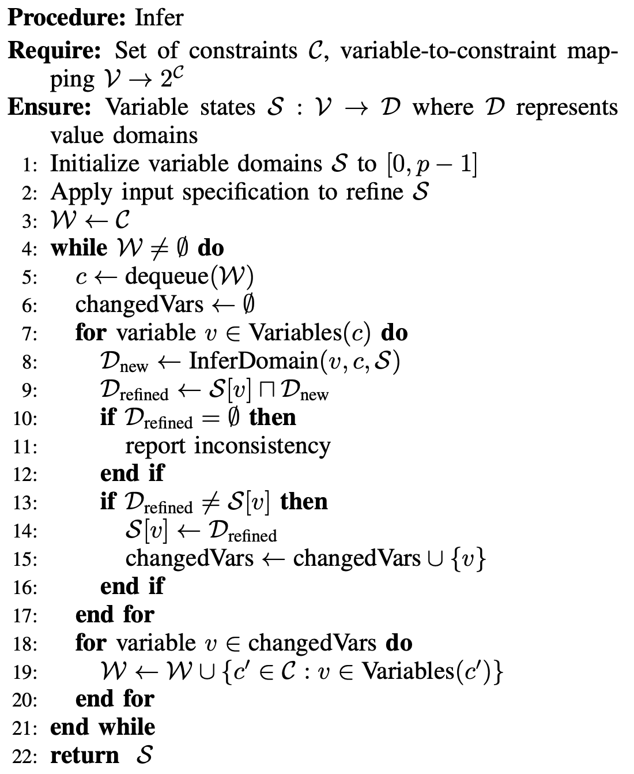
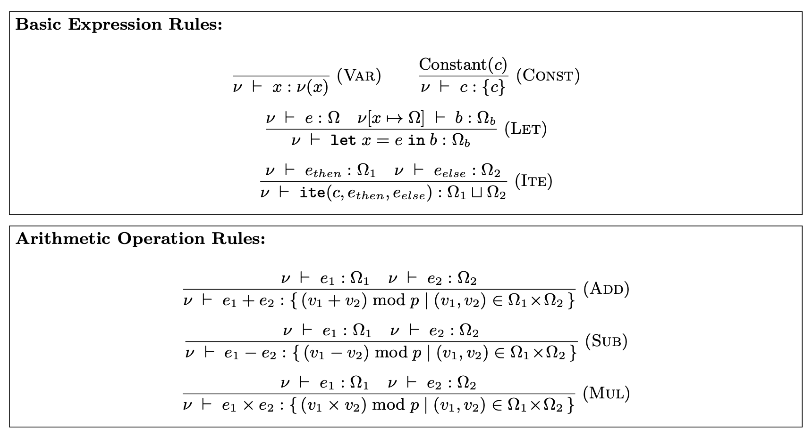
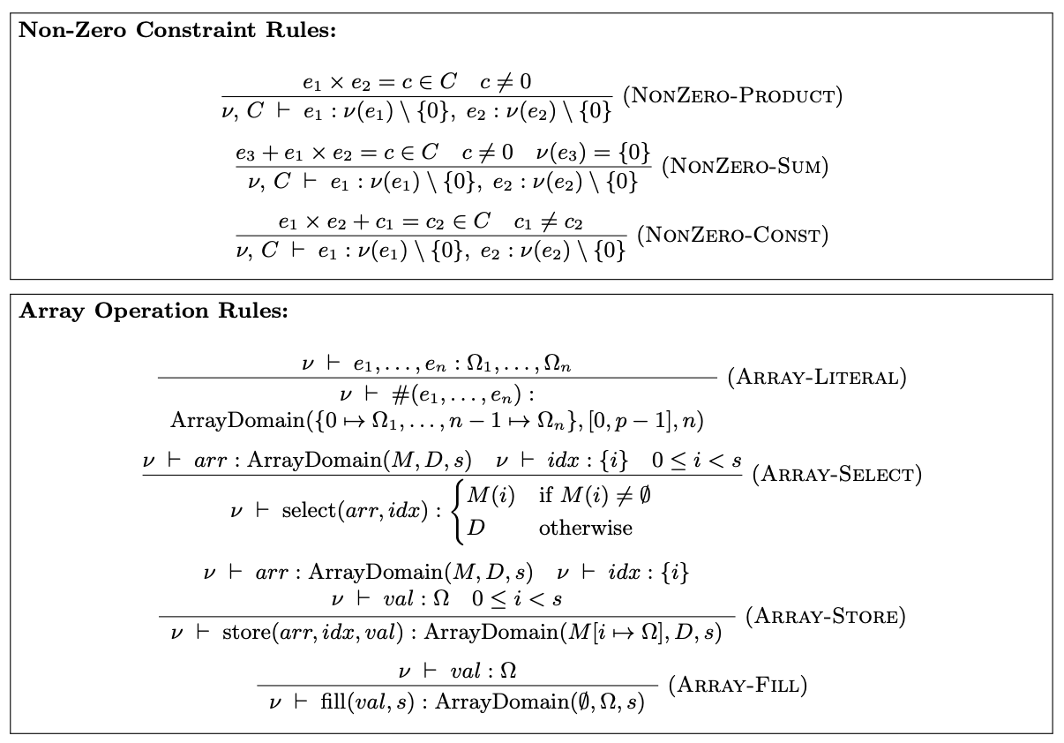
Inference Rules
x * (x – 2) === 0
x ∈ [0,2]
[Shankara Pailoor et al., PLDI 2023]
51
Notes:
Rules that exploit the fact that there are many re-occuring patterns in ZKP programs, and so these rules define that oh if you see this pattern, then you can refine the values of variables that occur in that pattern.
---
To give a very simple example
THAT's WHAT THE VERIFIER WILL ACCEPT
NONZERO EXAMPLE
---
Took these rules from the literature and extended them
---
Our algorithm keeps applying these rules, until a fixpoint is reached where we can derive no further value information.

Slide 44
template Division() {
signal private input a;
signal input {nonZero} b;
signal output out;
out <-- a / b;
out * b === a;
}
Insight #2: Abstract Values
template BadDivision() {
...
d <== Division(a, b);
out <== d.out;
}
out <-- a / b
out * b === a
a | b | out
maxval: 15 | nonZero | /
a | b | out
[0, 15] | [0, 5] | [1, 10]
It suffices to only keep track of signal tags on the computation side!
It suffices to approximate the values on the constraint side!
52

Slide 45
Contributions
Formalization: Domain Consistency Model (DCM)
Algorithm: Value Inference Engine
Implementation: Multi-Language Support
Evaluation: Discovery of Real-World Vulnerabilities
Notes:
AS YOU REMEMBER

Slide 46

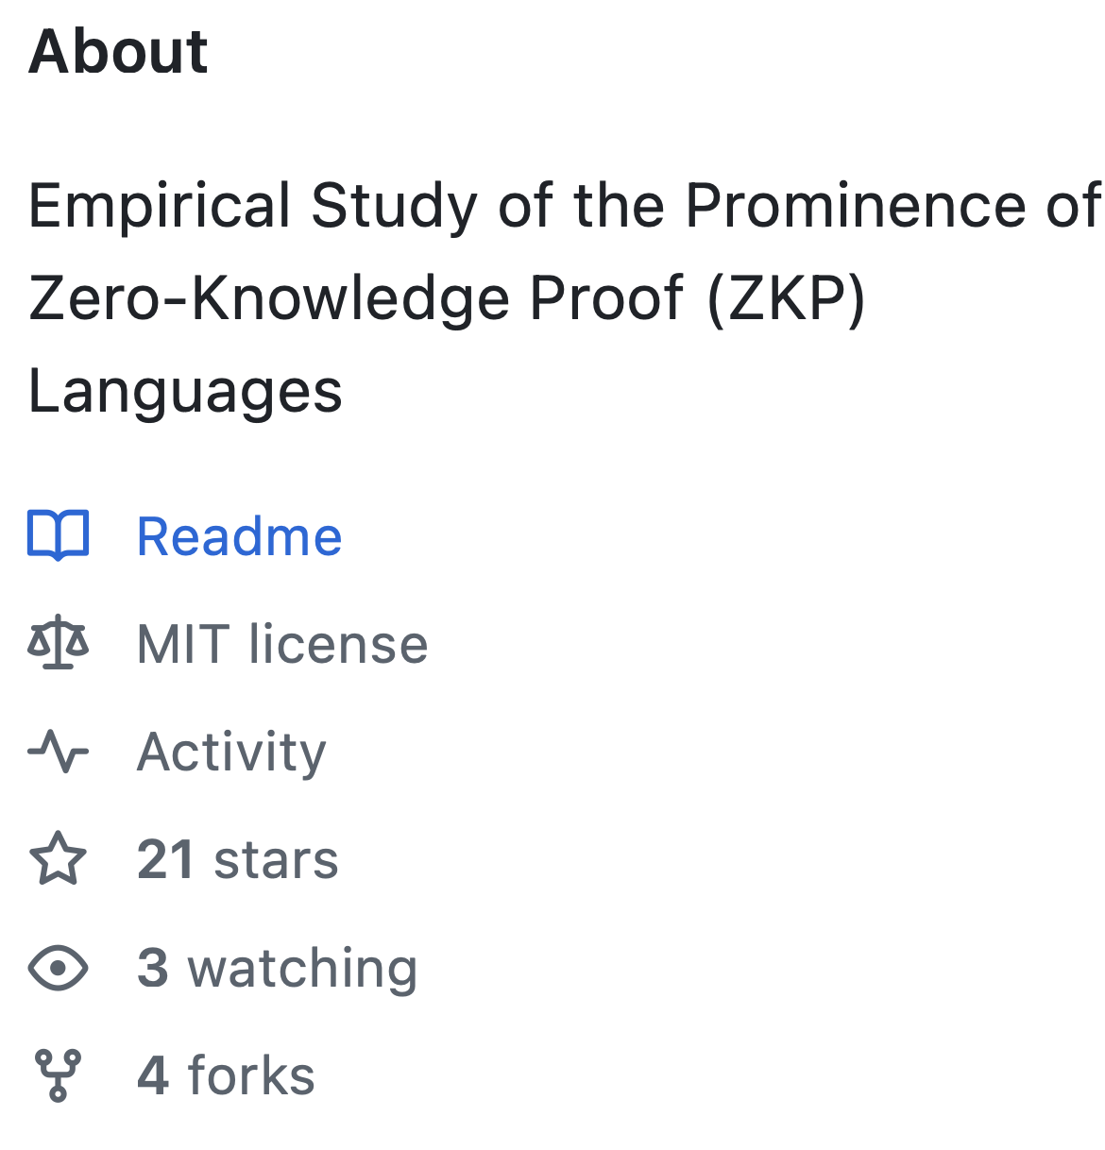
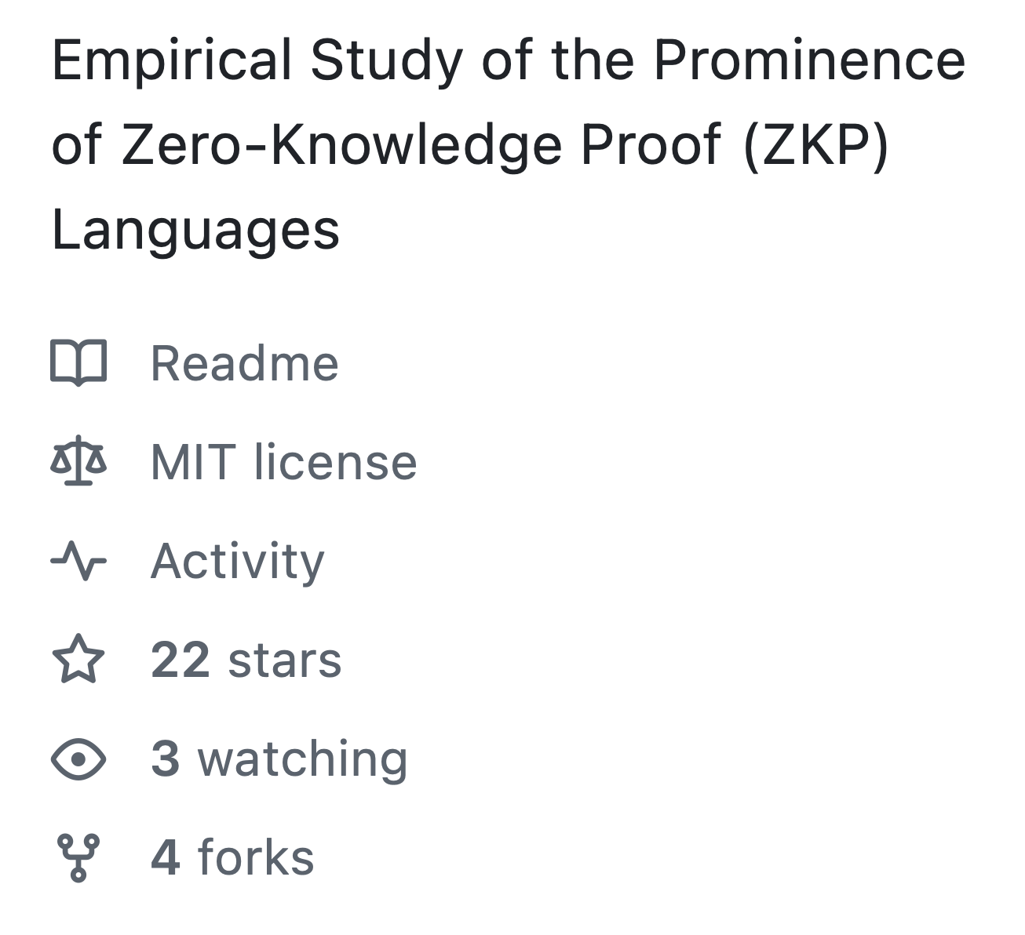
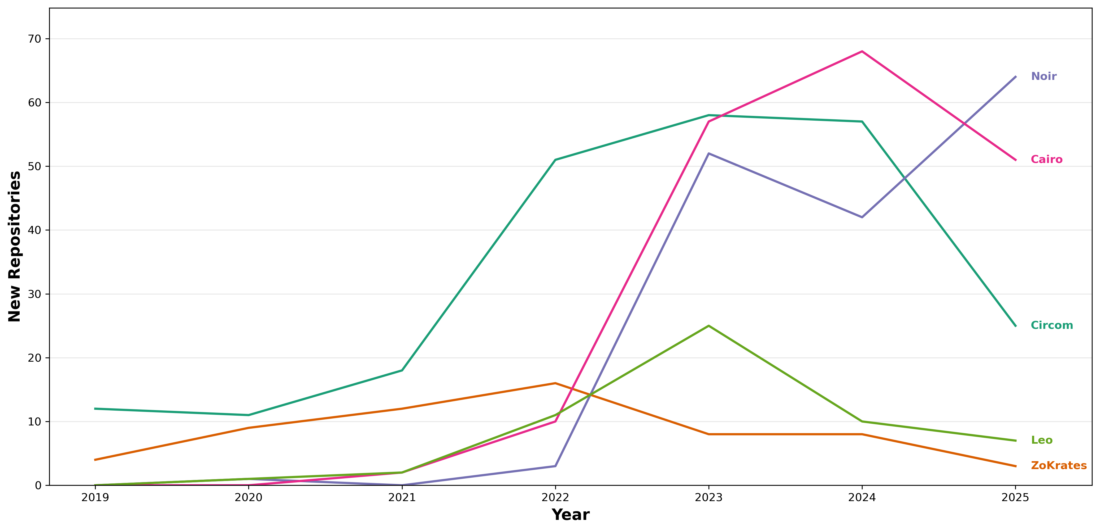
Multi-Language Support?
[Alex Ozdemir et al., IEEE S&P 2022]
Intermediate Representation!
Computations
Constraints
55
Notes:
From this we could see we need to support
the question: HOW?
CirC, which is a shared compiler infrastructure for cryptographic tools like ZKPs which for example translates ZKP programs to different output formats for different goals . But what is important for us, is that it operates over an intermediate representation, the CirC IR. This means that if we build our tool for this IR, we support all the languages that it supports. Because all you have to do
like R1CS (used for proof systems), SMT (used for verification and bug-finding), and ILP (used for optimization)

Slide 47
Contributions
Formalization: Domain Consistency Model (DCM)
Algorithm: Value Inference Engine
Implementation: Multi-Language Support
Evaluation: Discovery of Real-World Vulnerabilities

Slide 48
Evaluation

Slide 49
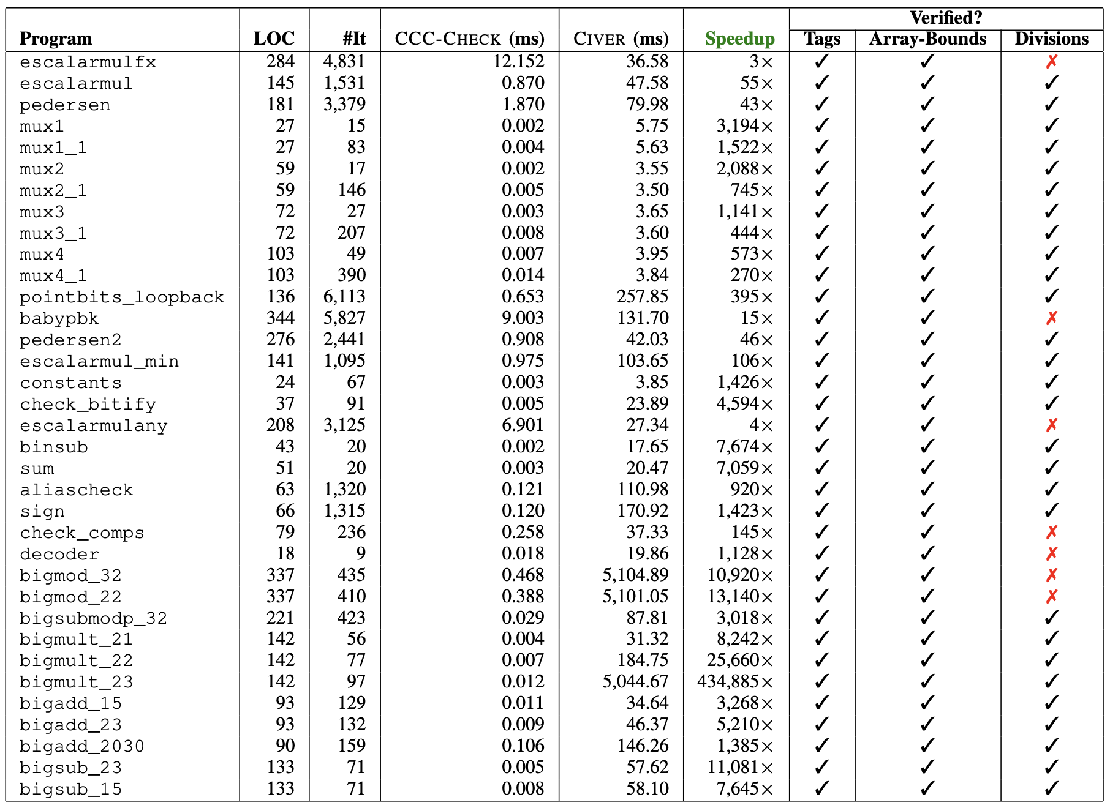
How effective is our approach in verifying tagged programs?
Comparison of time and effectiveness against SMT-based approach (CIVER)
35 tagged benchmark programs
On average two orders of magnitude faster
div-by-zero false positives due to over-approximation
58

Slide 50


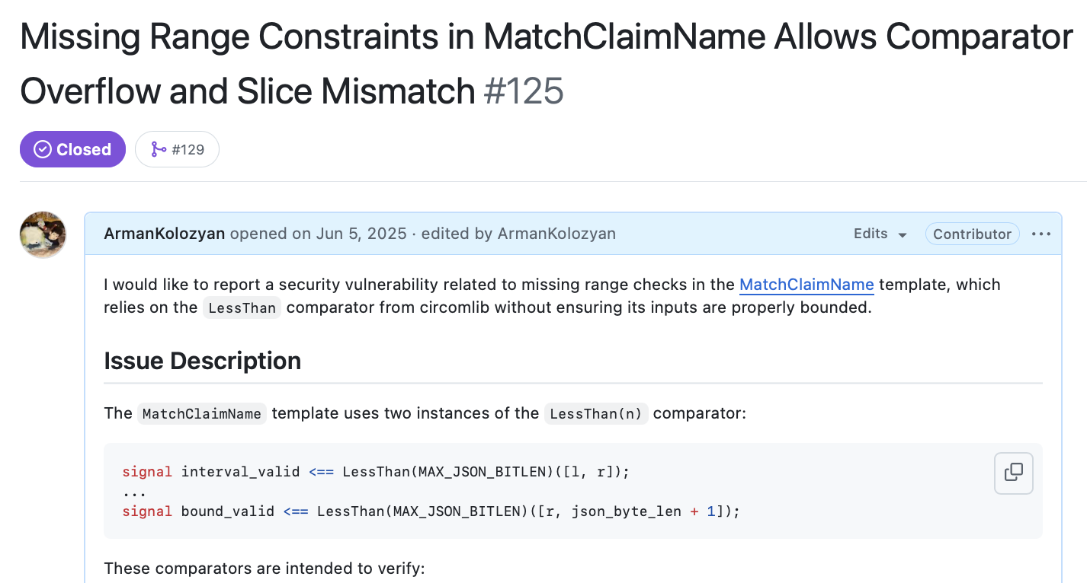
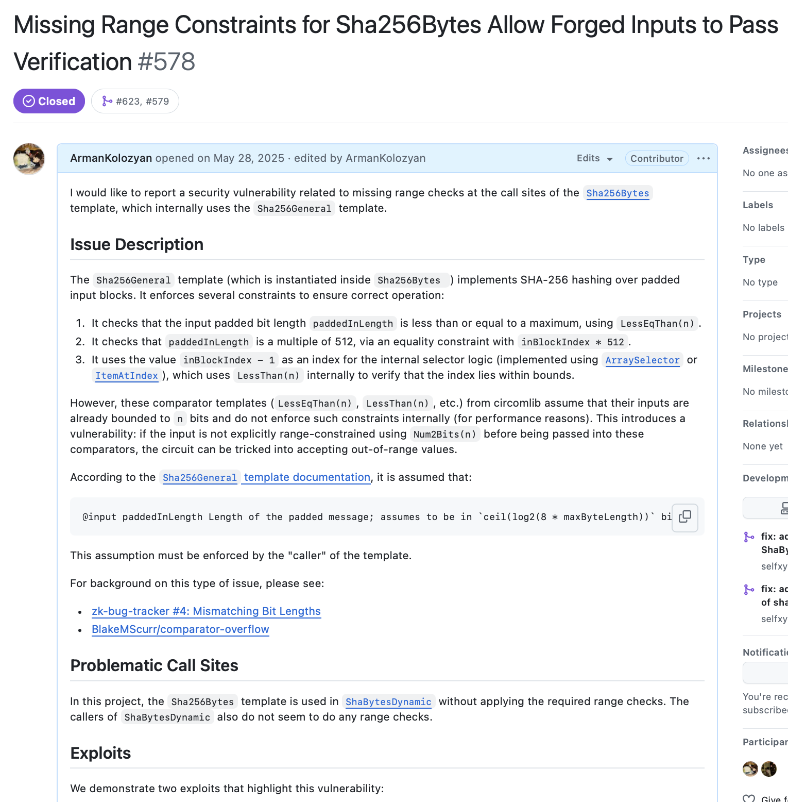
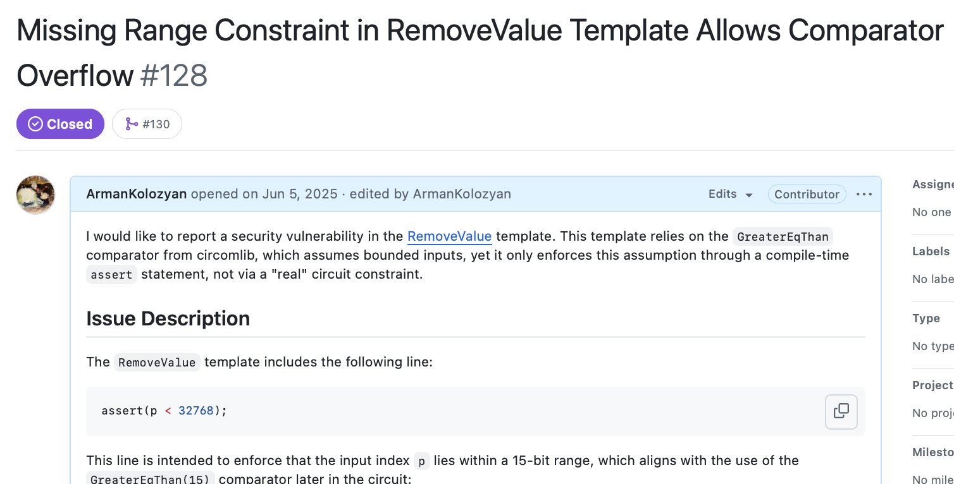
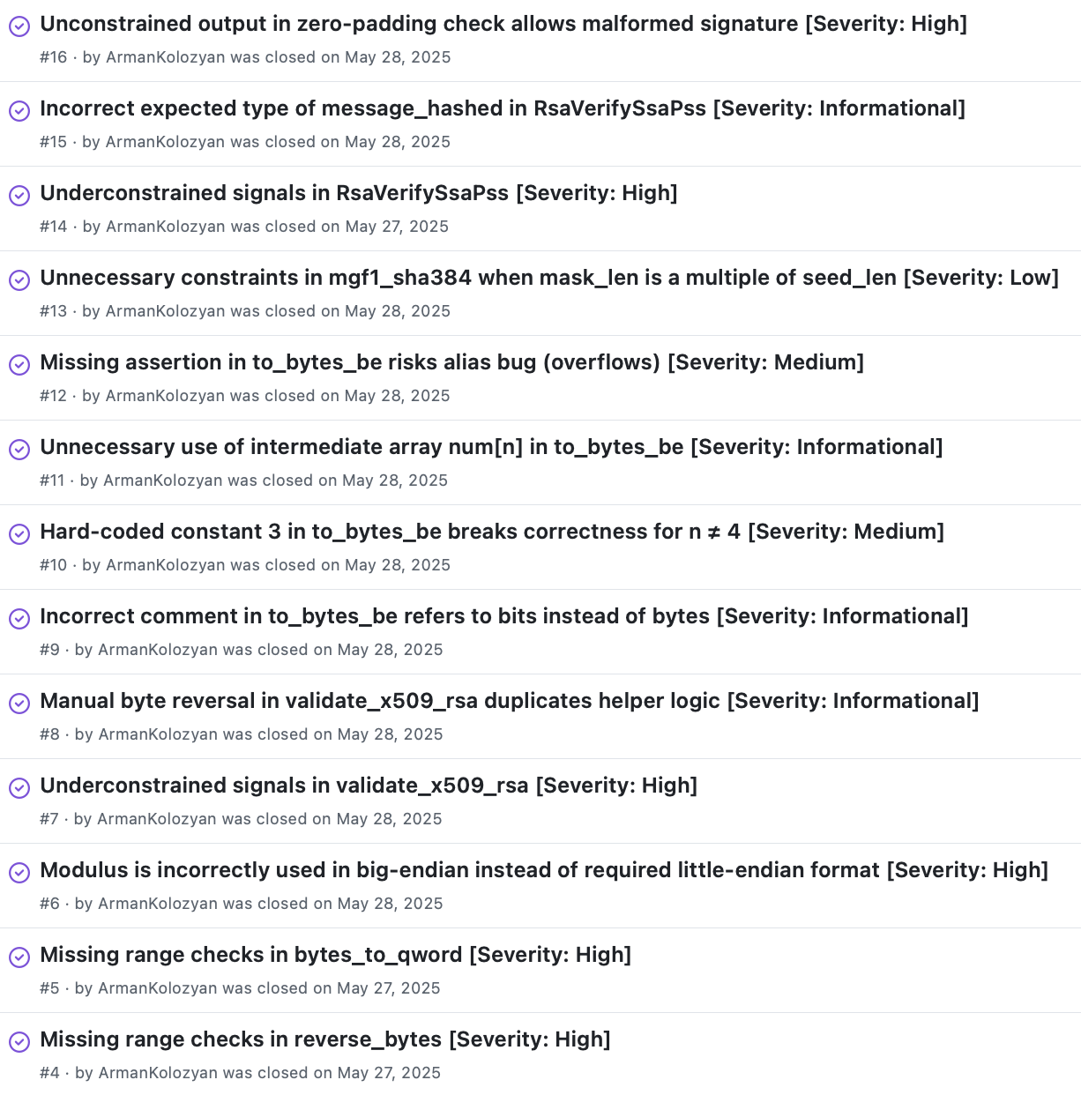
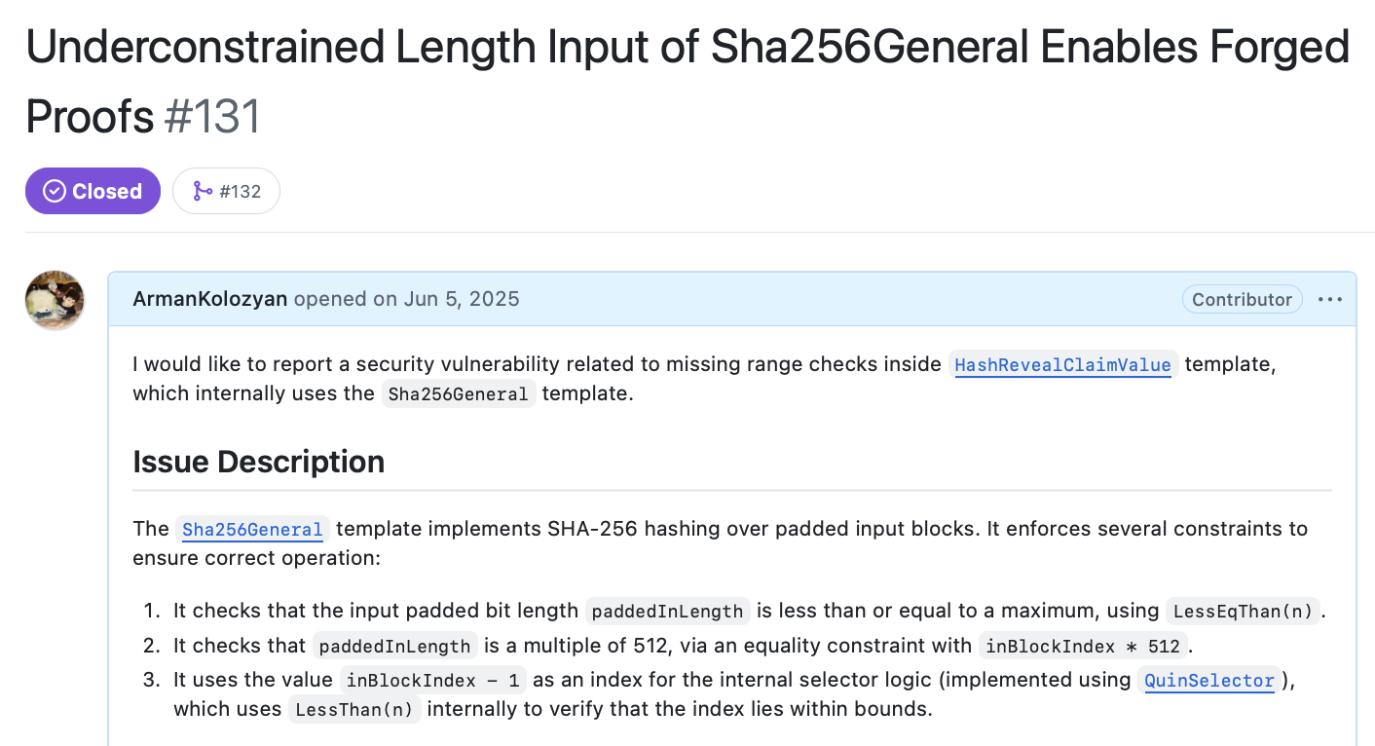
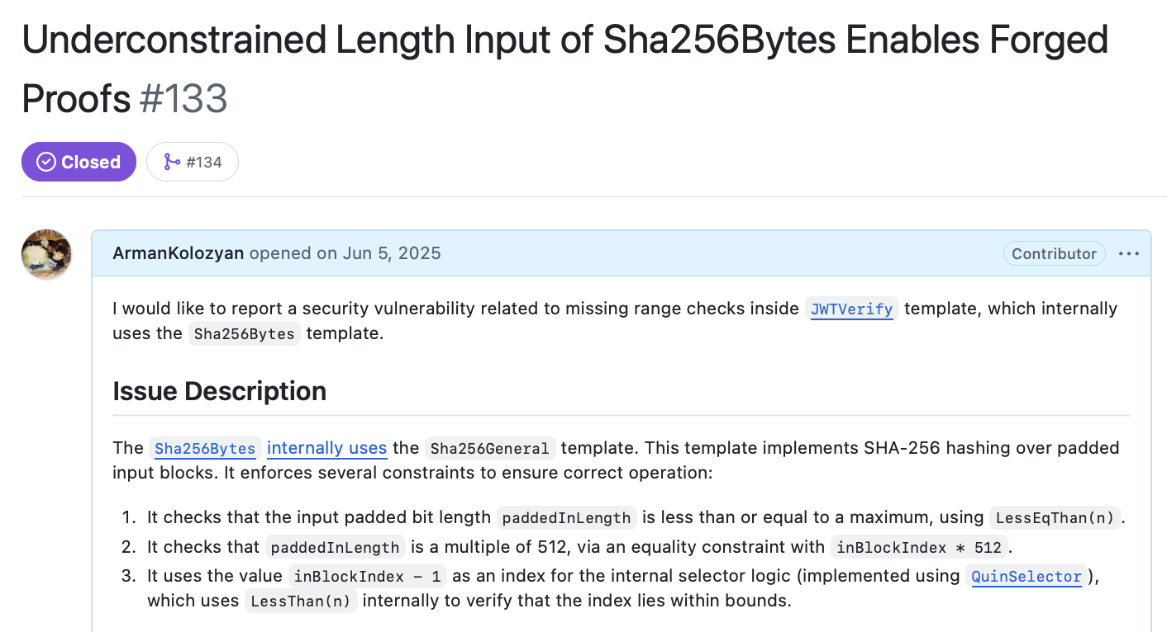
How prevalent are semantic mismatches in real-world programs?
59
Notes:
Possession of valid mobile driver’s license
Third party TEE is legitimate
Missed durring the audit by a major ZKP auditing company!!!!
BUG BOUNTY!!!!

Slide 51




Language-Agnostic Detection of ZKP Bugs
Arman Kolozyan
Detect Computation-Constraint Mismatches!
ZKP programs often violate (implicit) assumptions.
out <-- a / b
out * b === a
Specifications (e.g., signal tags)
Abstract values
There is a need for language-agnostic bug detectors!
Use Intermediate representations!
arman@kolozyan.com
62
Notes:
The specifications can help you to already get a rough idea of what an honest prover is expected to do and similar approximation can be done on the verification side via abstract interpretation.
more recently another IR, which highlights the significance of this contribution
if you would like to dive deeper into the technical details
happy to take on any questions

